Slide 1
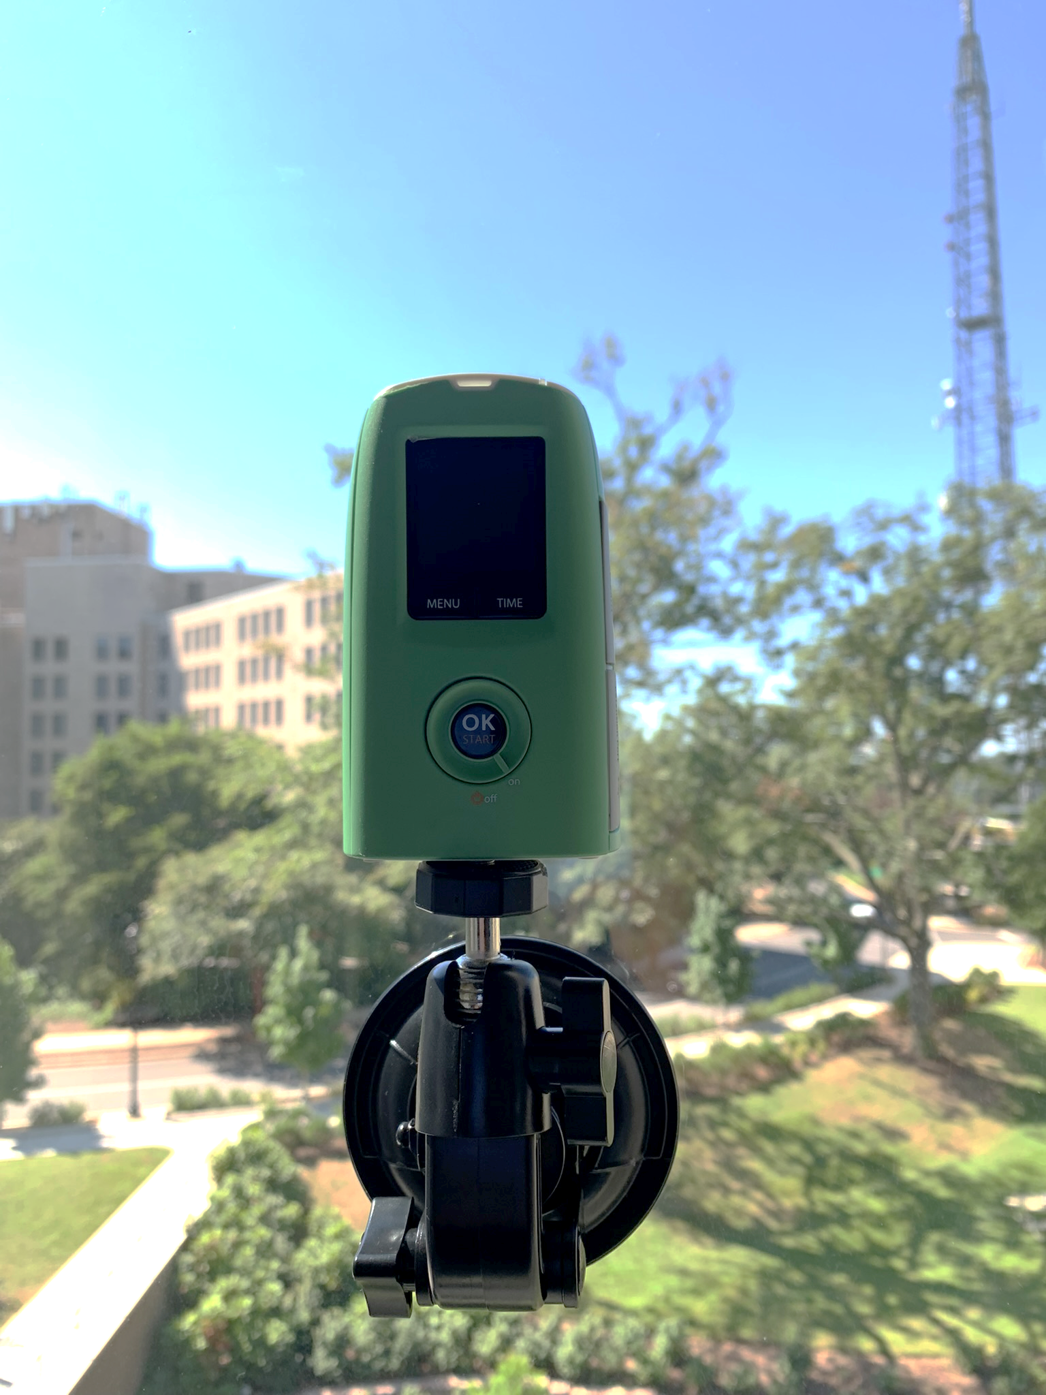
Investigating The Variability of Urban Tree Phenology Using Volunteer-hosted Phenocams
Presented by Maya Hall
Advisor: Dr. Michael Alonzo
Committee Members: Dr. Valentina Aquila and Dr. Sauleh Siddiqui

Slide 2
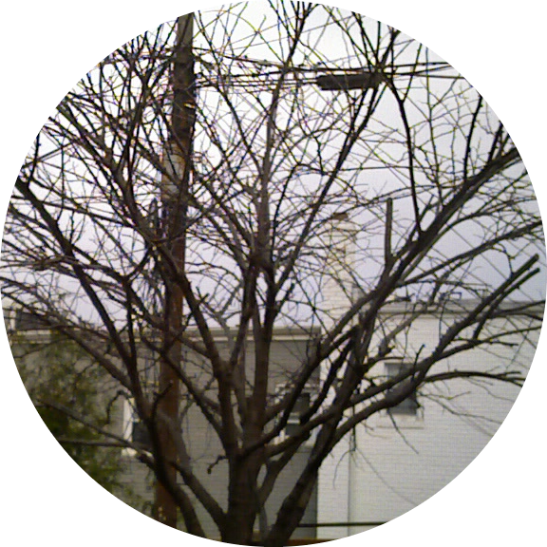

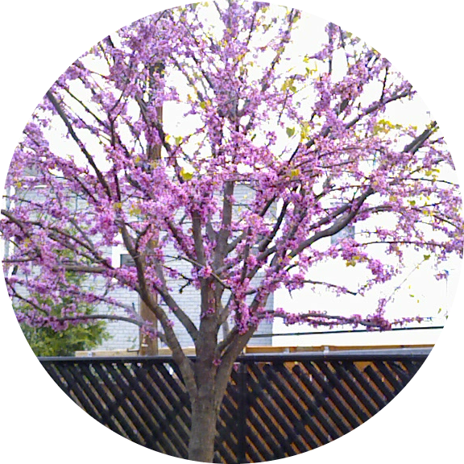
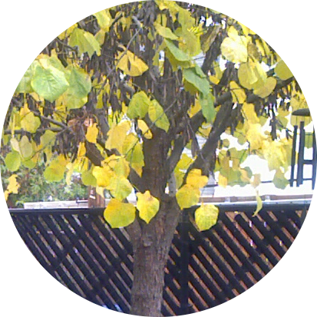
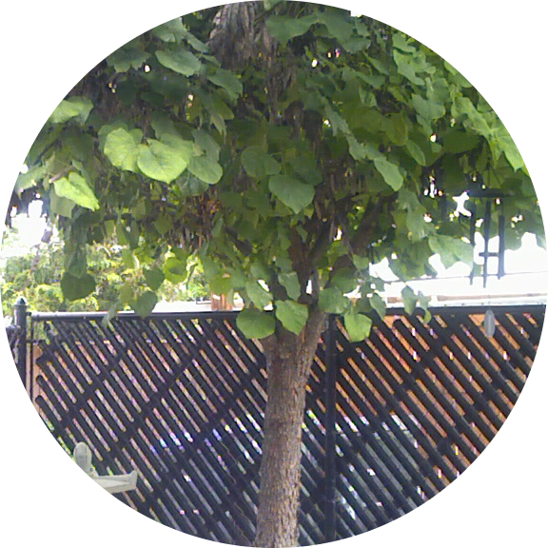
Background
Phenology: the study of cyclic and seasonal natural phenomena in the lives of plants and animals

Slide 3
Drivers Of Phenology
Background
Photoperiod
Precipitation
Topography
Temperature
Phenological Events
Genetics

Slide 4
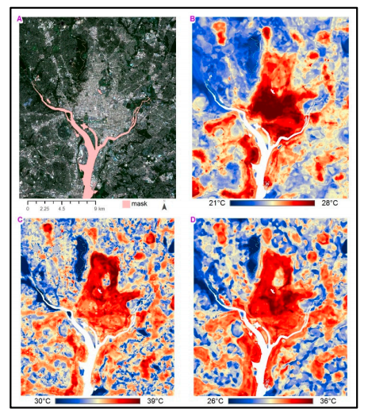
Urban Heat Island (UHI) Effect
Background
Advance in spring events
Delay in autumn events
Extension of growing season
Washington, D.C. (A) aerial imagery with major waterbodies masked; (B) morning UHI; (C) afternoon UHI; (D) evening UHI. (Shandas et al. 2019)

Slide 5
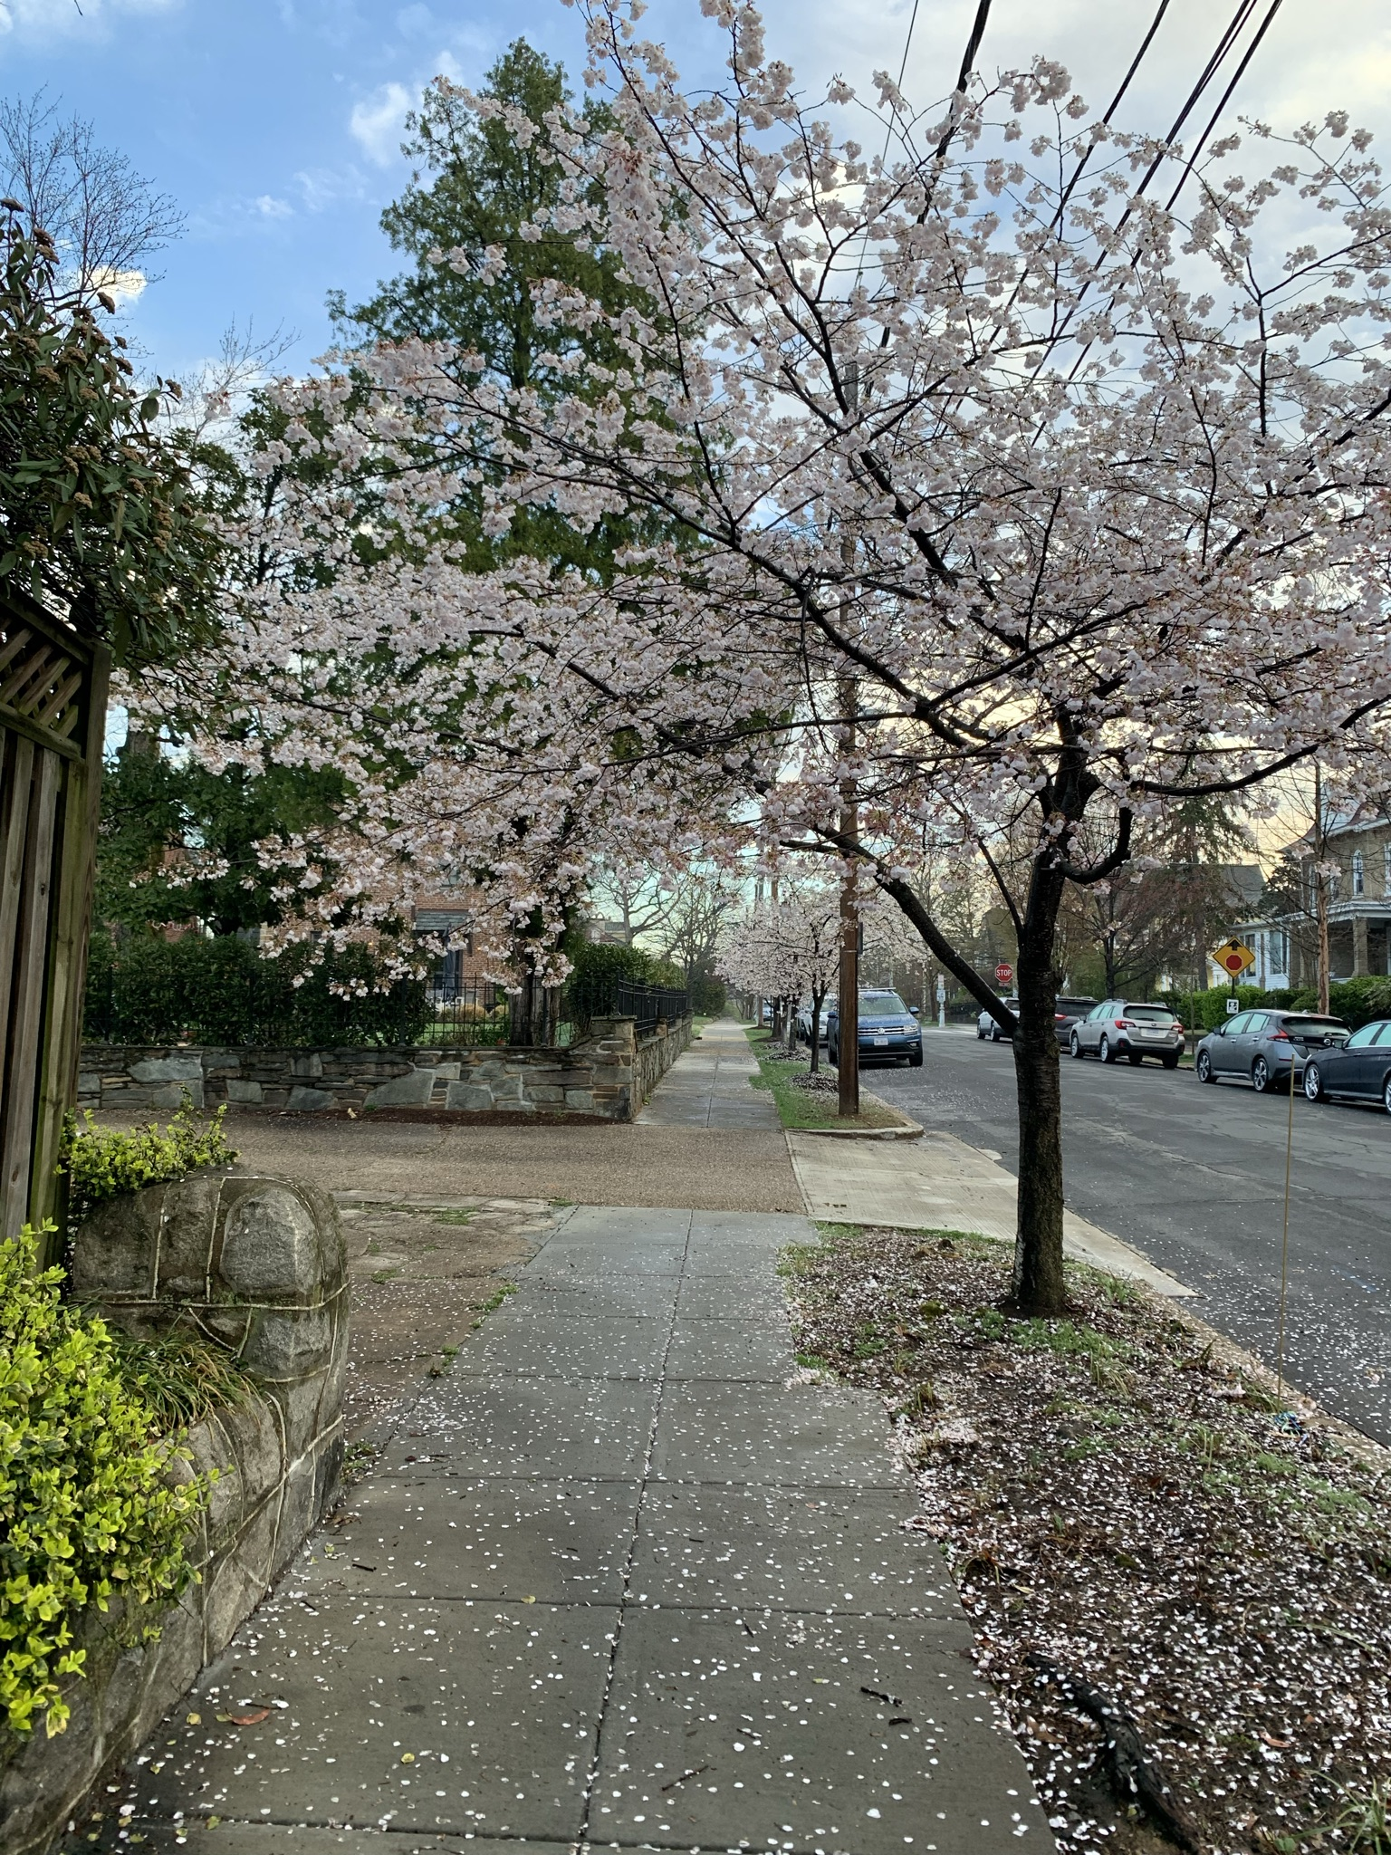
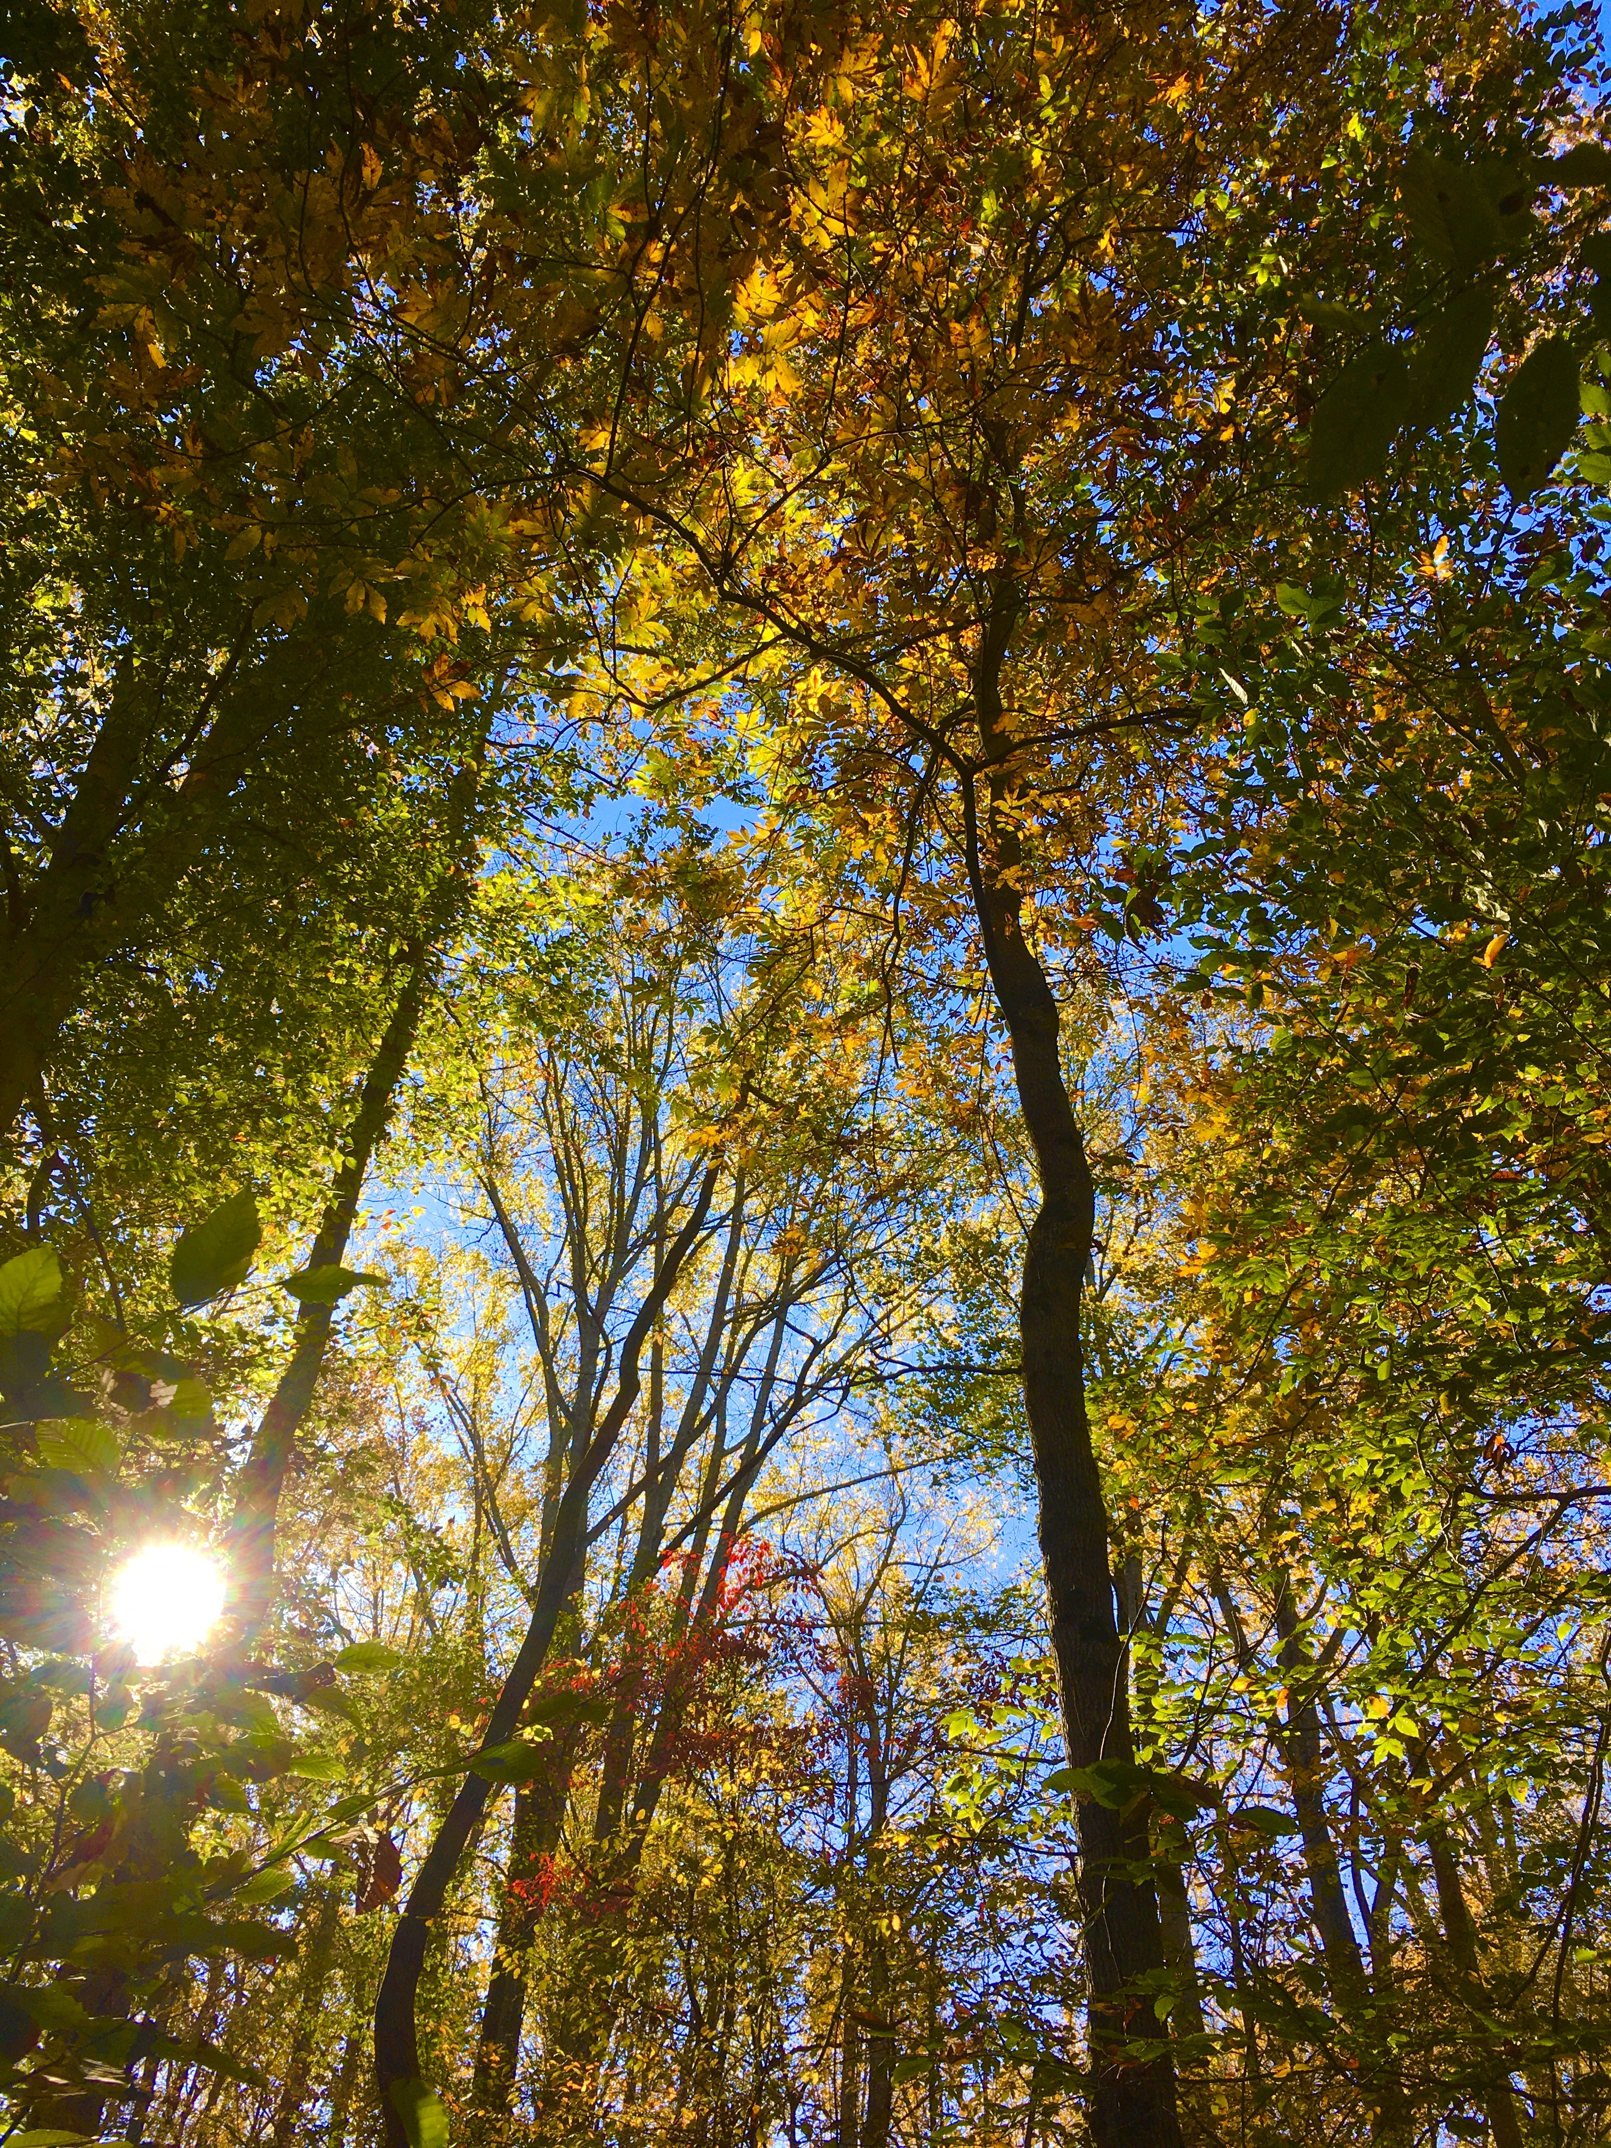
Motivation – Importance of Urban Phenology
Background
Ecosystem services
Phenology as an indicator
Proxy for future responses

Slide 6
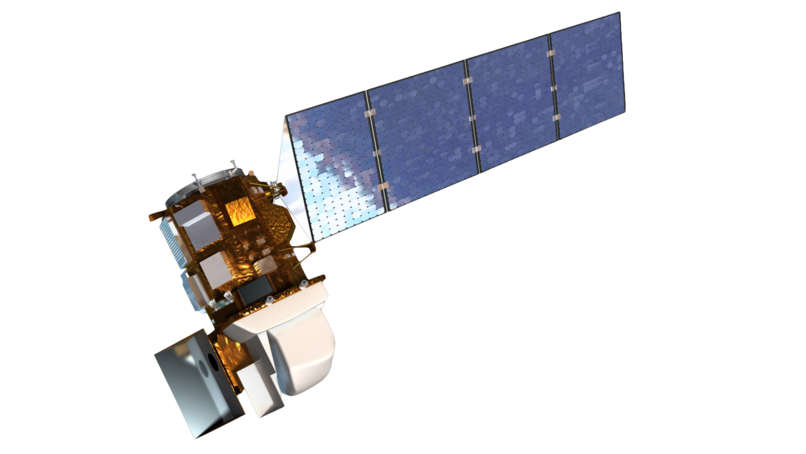
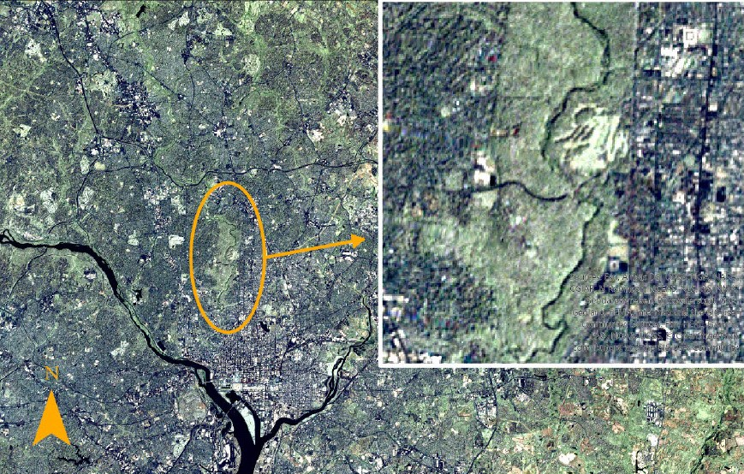
Methods of Phenological Data Collection
Background
Landsat 8
Ground-based Observations
Satellite Remote Sensing
Satellite | Spatial Resolution | Temporal Resolution
MODIS | 250m – 1000m | 1-2 days
Landsat | 30m | 16 days
Harmonized Landsat Sentinel-2 (HLS) | 30m | 2-3 days
1 Mile
Washington, D.C. NASA/USGS Landsat 2005. 30mx30m
Notes:
White et al. 2002 – 8 days prolongation satellite
Studer et al. 2007 – advance of spring with satellite and ground-based

Slide 7
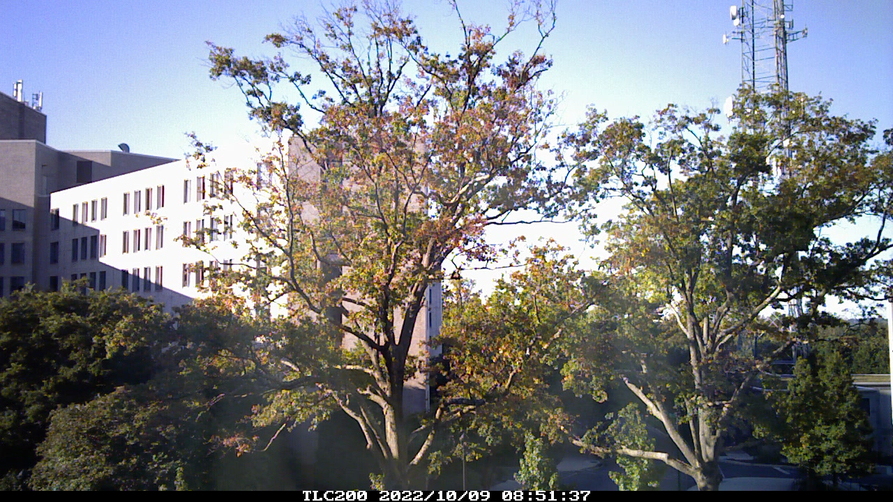
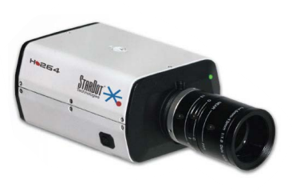
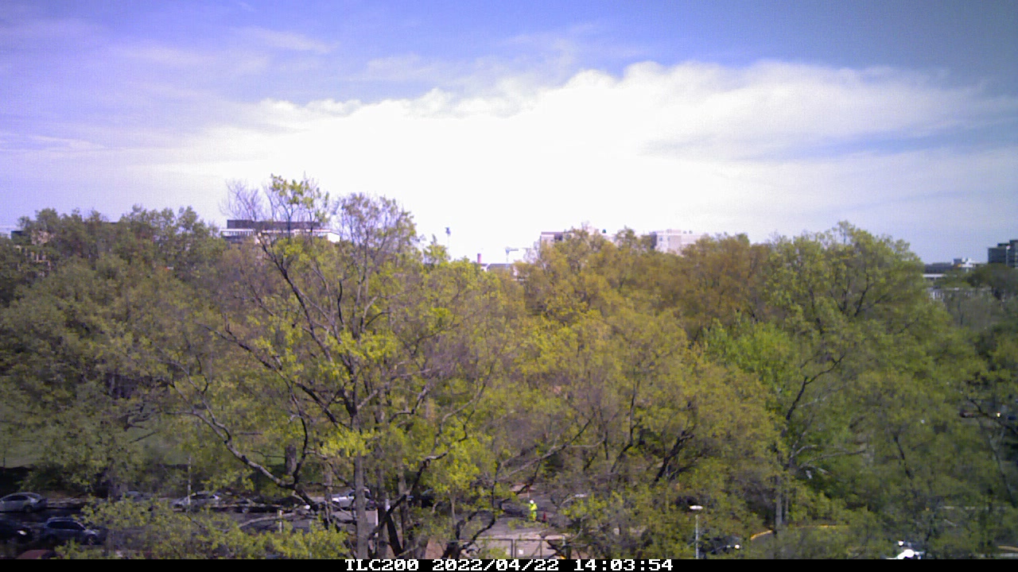
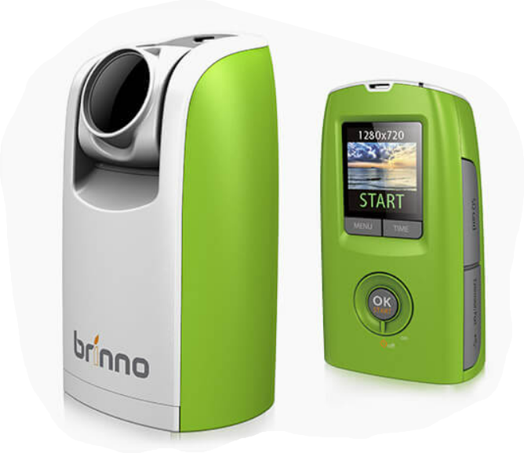
Phenocams
Background
Near-continuous
Accessible and flexible
Near-surface
StarDot NetCam
Brinno Digital Camera
Top: HoS EOS 2022; Bottom: Delaware Ave. SOS 2022
Notes:
Jochner & Menzel 2015 - differences between the city and the countryside can be used for more than temporal and spatial analysis of the urban heat island effect; can provide evidence on how phenology will respond to future temperature increase and to alterations of other environmental conditions typical for the urban climate
Necessary to distinguish between the effects of local urban warming and the more general characteristics of global climate change

Slide 8
Research Aims
Aim 1: Test the extent to which phenocam imagery can track urban phenology changes influenced by regional air temperature and precipitation
Aim 2: Explore the variability of urban tree phenological responses across phenocam site and genera
Aim 3: Examine the suitability of phenocams as reliable and practical tools for urban phenology studies and explore the implementation of volunteers as phenocam hosts

Slide 9
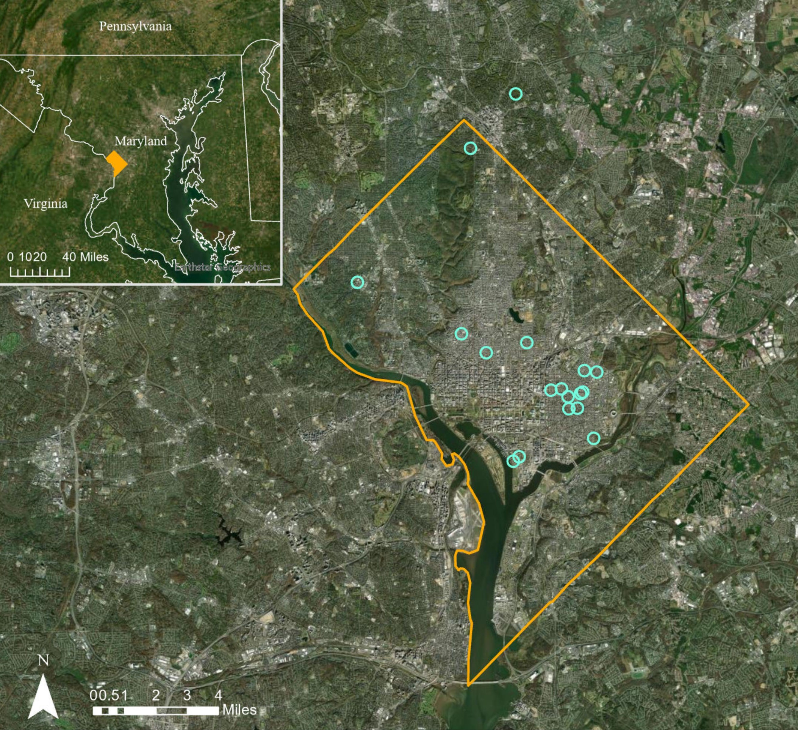
Study Site: Washington, D.C
Methods
Humid subtropical climate
38% canopy cover
39% impervious surface cover
Phenocam locations based on Casey Trees volunteers
Washington, D.C. study site with district borders outlined in orange and each phenocam location symbolized as a bright blue circle

Slide 10
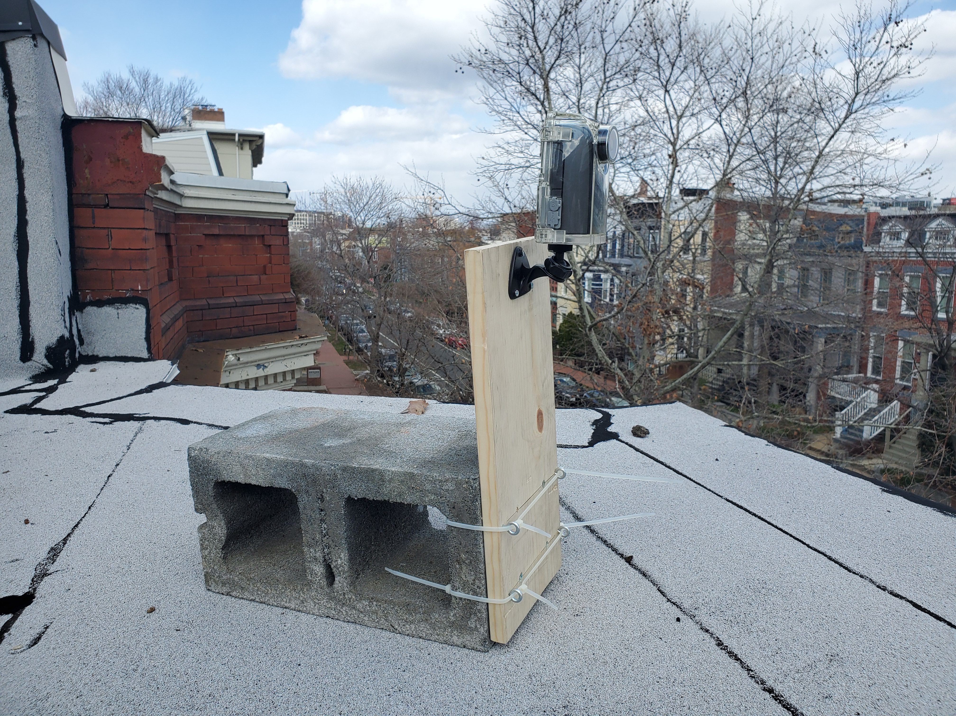
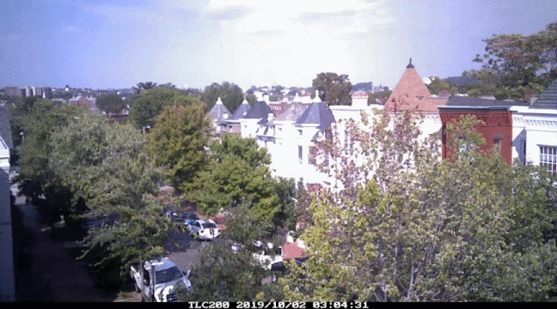
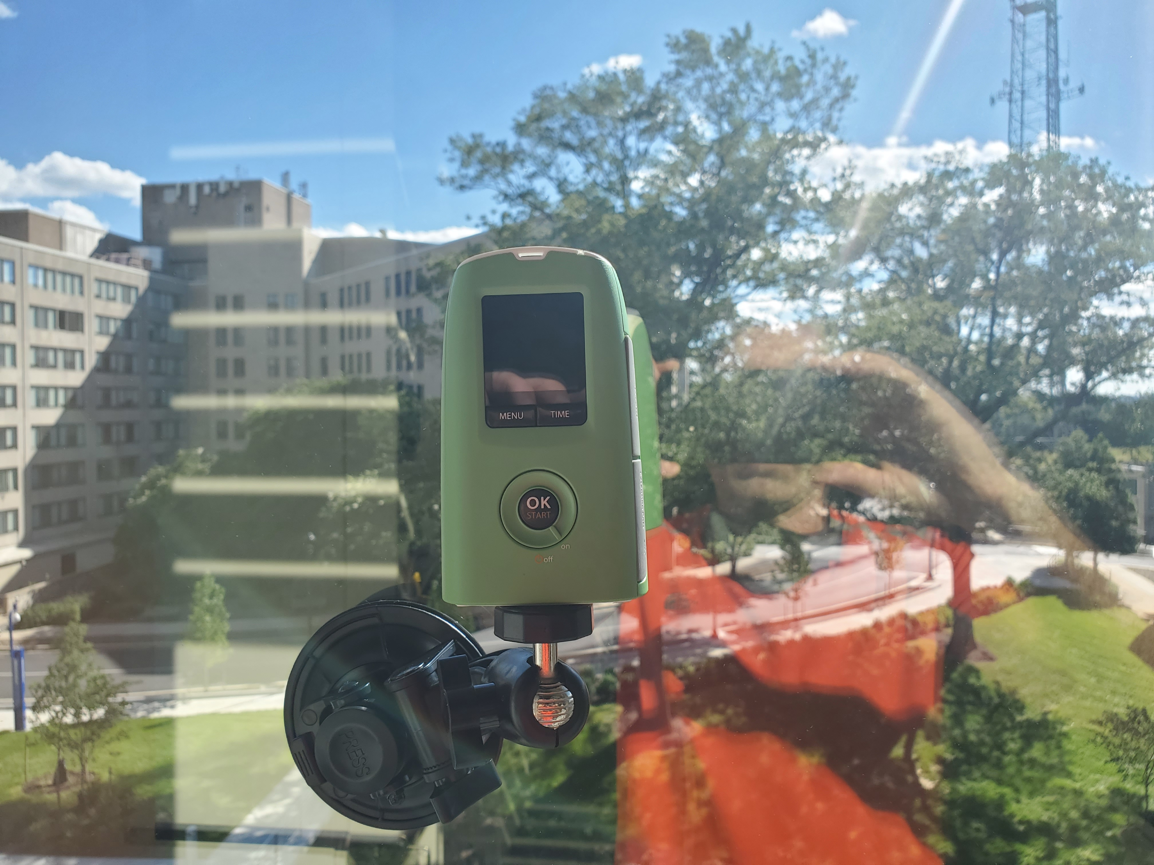
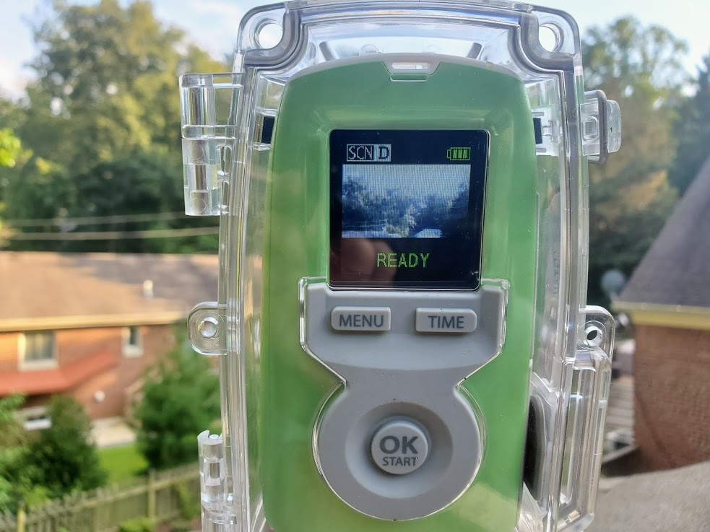
Phenocam Installation and Data Collection
Methods
Above: raw video from phenocam; Right: Examples of phenocam set-ups

Slide 11
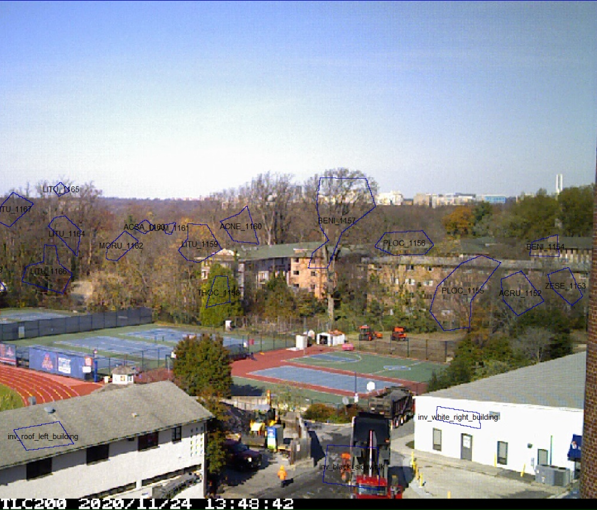
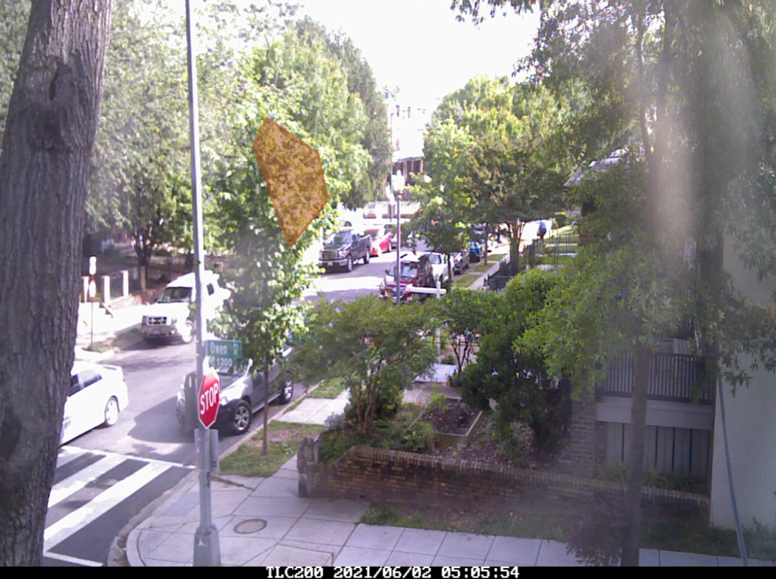
Daily Images and xROI
Methods
Left: Example of an ROI in xROI GUI; Right: Example of drawn and labeled ROIs.

Slide 12
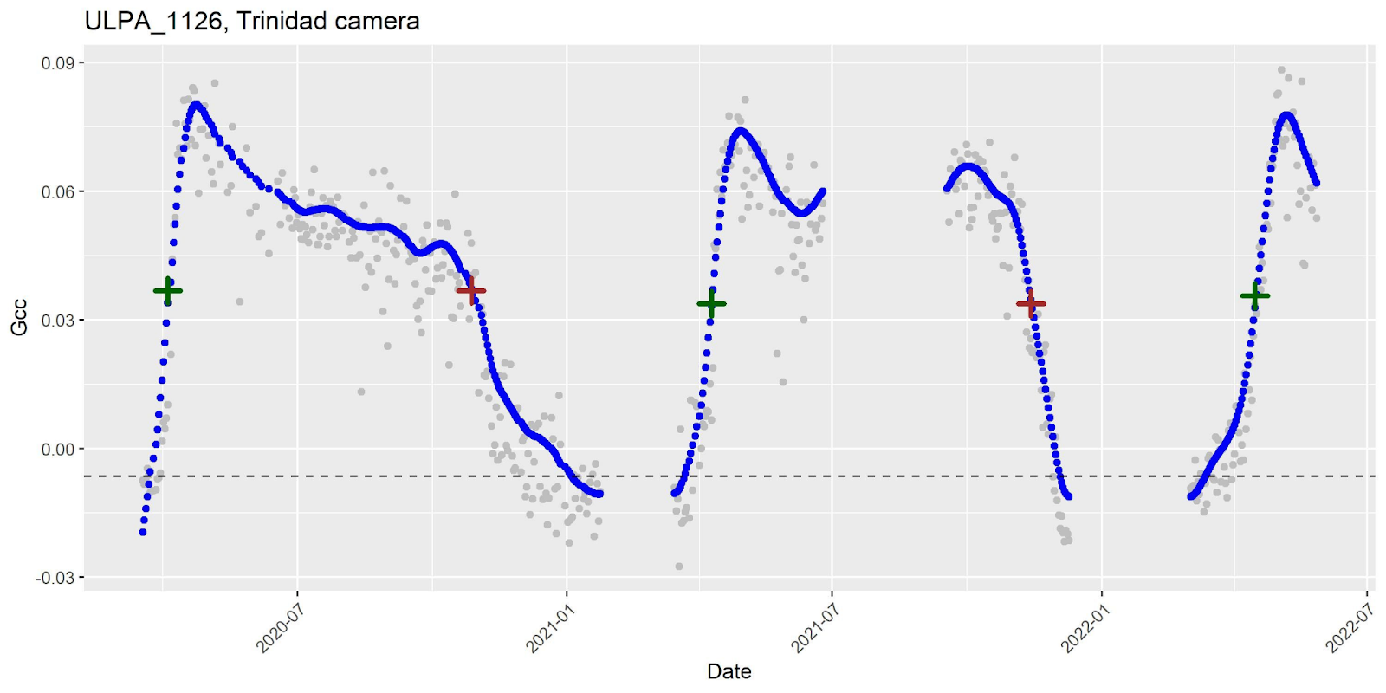
Spline Interpolation and Phenometrics
Methods
EOS
SOS
Example of spline interpolation

Slide 13
Interannual Differences in Phenometrics
Methods
Tukey’s Honest Significant Difference (HSD)
Significant phenometrics
Analysis of Variance (ANOVA)
Start of season (SOS)
End of season (EOS)
Growing season length (GSL)
Visualize as Boxplots
All phenometrics

Slide 14
Statistical Analyses
Methods
Aims 1 & 2 – Climate, Site, and Genus
Hierarchical Mixed Effects modeling
Ordinary Least Squares modeling
Visualization of genera differences
Key Model Evaluation Steps
MAD and R²
BIC minimization

Slide 15
Model Variables
Methods
 | Variable Name | Short Name | Description
Regional Variables | Temperature | TEMP | Monthly and daily minimums, maximums, and averages from NOAA
 | Precipitation | PRECIP | Monthly averages and totals from NOAA
Site Variables | Impervious surface | IMP | Impervious surface from City of D.C. planimetric data
 | Tree canopy | TCF | 1 m tree canopy map derived from 2018 City of D.C. lidar data
 | Elevation | ELEV | City of D.C. lidar Digital Terrain Model (2018)
Random Effects | Year | Year | 2020 – 2022
 | Phenocam | Phenocam | Individual phenocams
 | Genus | Genus | Street tree identities provided by D.C.’s Urban Forestry Division (UFD)
Notes:
Alonzo et al. accepted
Mimet et al. 2009 – 8 days preceding
Luo et al. 2006 - Preceding 1, 6, and 12 months to the month of a phenophase
Menzel 2003 - spring + summer anomalies strongly correlate with temperature of preceding months
Pellerin et al. 2012
Wang et al. 2014 - 60 days before a phenological event
Basler and Korner et al. 2014 - November and January daily mean temps
Liu et al. 2015
Xie et al. 2015 - precip. summarized from daily data over the growing season
Jin et al. 2019 - Mean temp and precip for each period

Slide 16
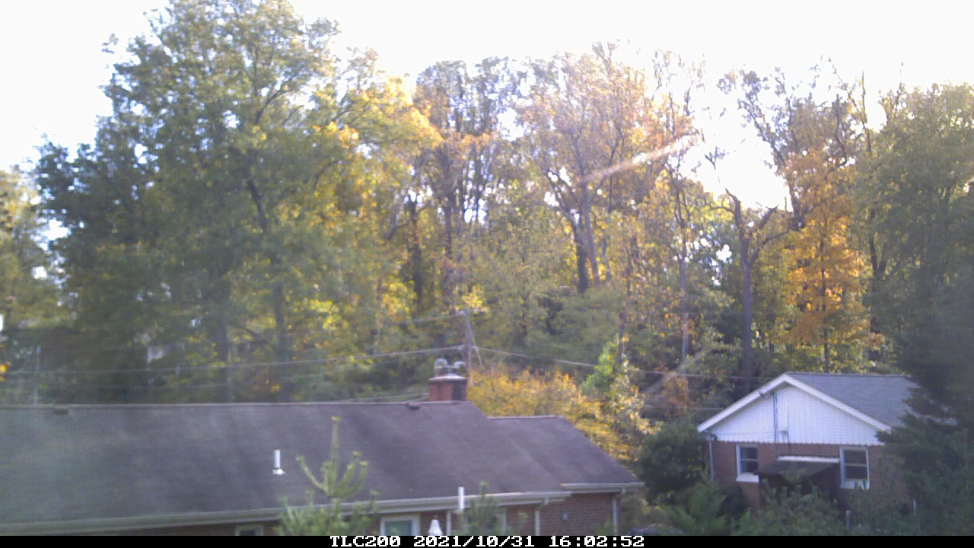
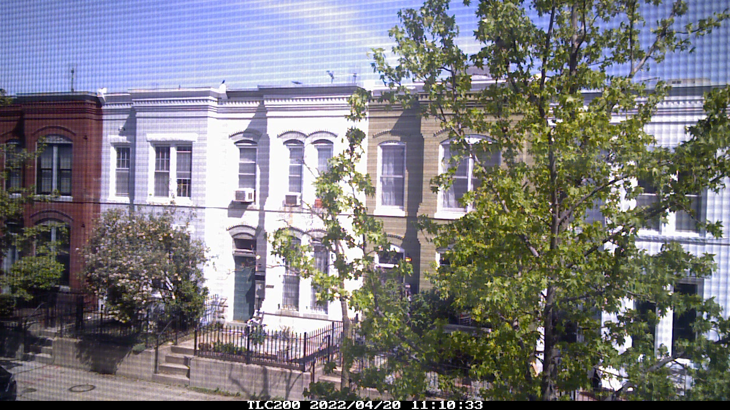
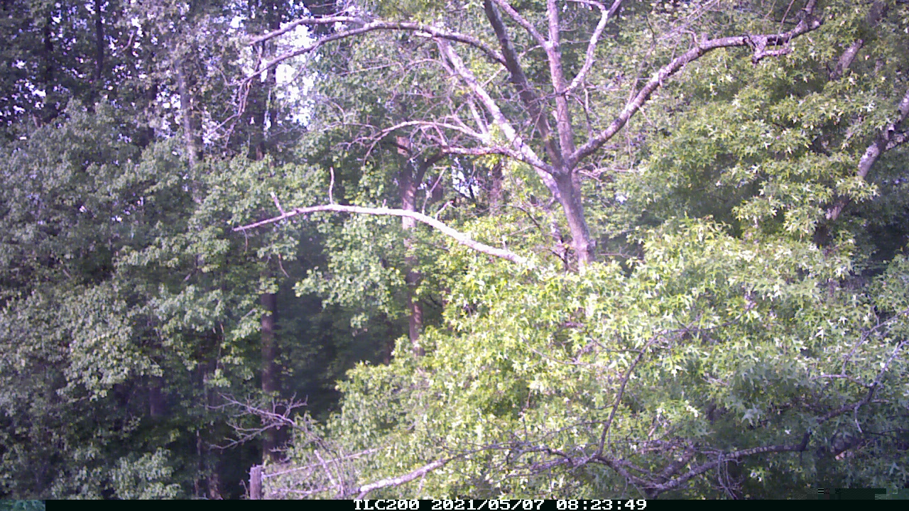
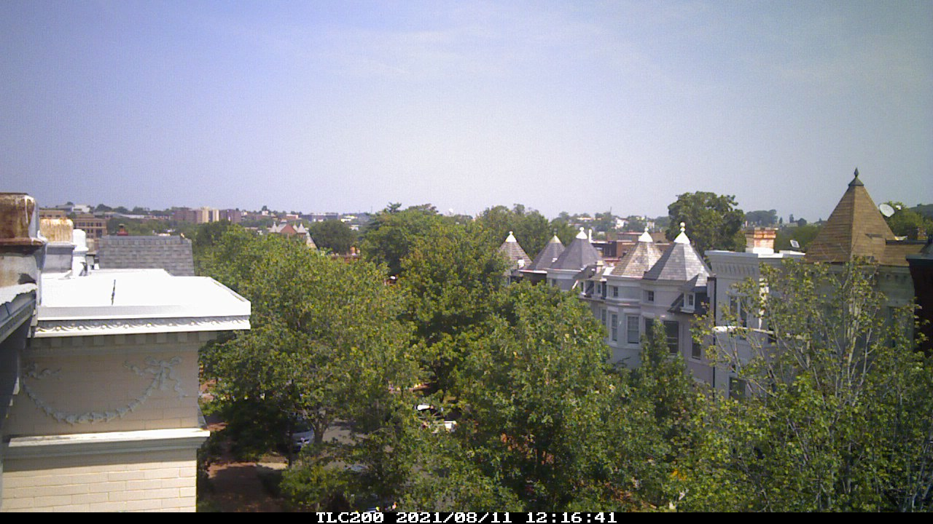
Method Evaluation
Methods
Aim 3 – Volunteer-hosted Phenocams
Assess benefits and complexities of phenocams
Evaluate influence of volunteer-based sites
Provide recommendations

Slide 17
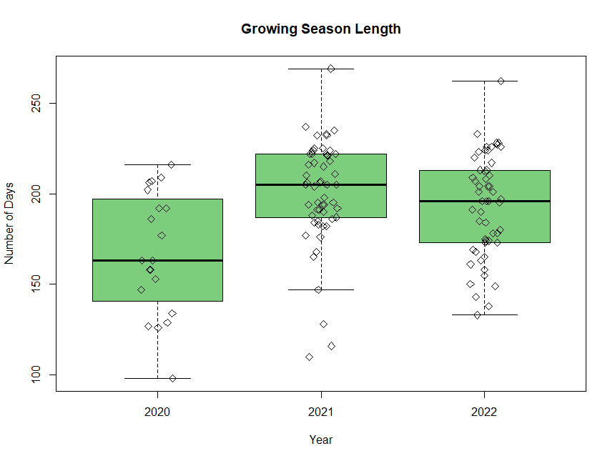
Interannual Variation
Results

Slide 18
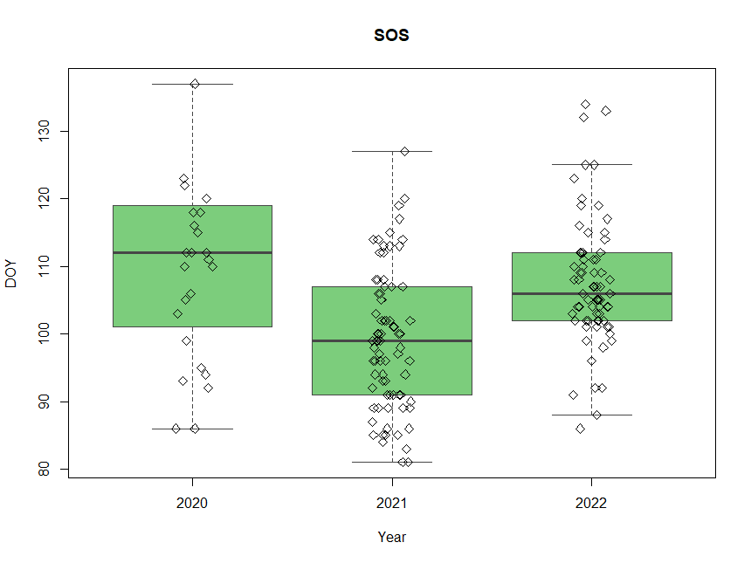
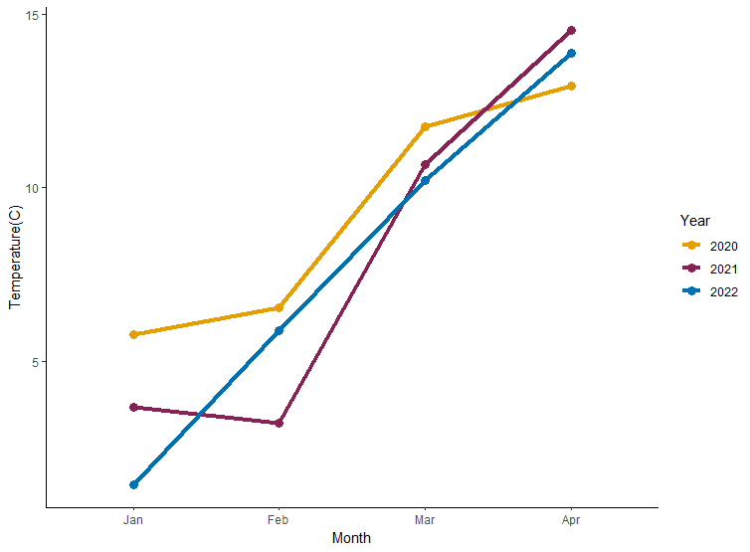
Interannual Variation
Results
Notes:
Jin et al. 2019 – spring warming 2.47 days
Chuine et al. 2010

Slide 19
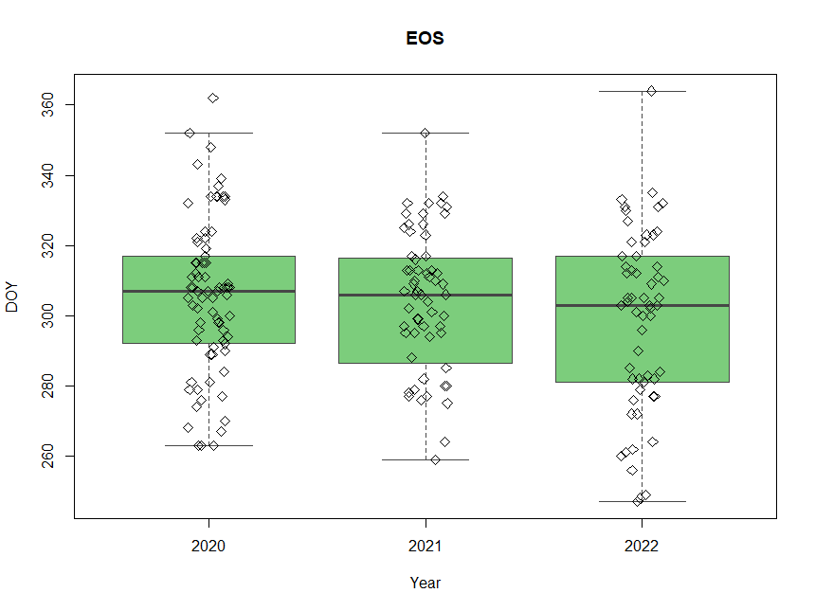
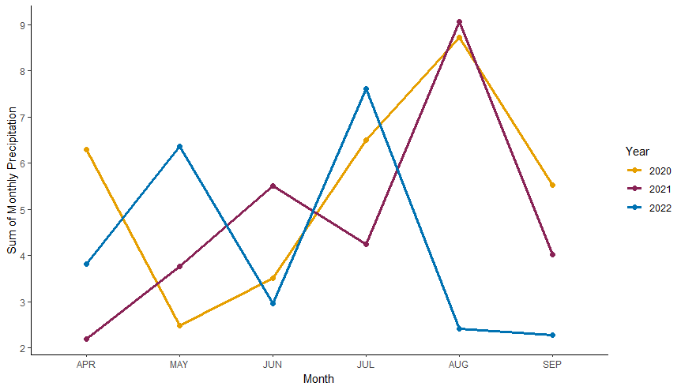
Interannual Variation
Results

Slide 20
Hierarchical Mixed Effects Models
Results
$$SOS=\%IMP+\%TCF+ELEV+TEMP+ (1|Phenocam)$$
R² = 0.38
MAD = 5.03
$$EOS=\%IMP+\%TCF+ELEV+TEMP+PRECIP+ (1|Phenocam)$$
R² = 0.36
MAD = 10.26
Notes:
Model performance indicators

Slide 21
Hierarchical Mixed Effects Model: SOS
Results
 | IMP | TCF | ELEV | TEMP
Coefficient | 33.12 | 13.64 | -0.06 | 25.72
Std. Error | 60.23 | 63.82 | 0.16 | 9.01
t-value | 0.55 | 0.21 | -0.34 | 2.85
p-value | 0.60 | 0.84 | 0.71 | 4.86e-3*
*statistical significance at the 99% level
Notes:
Jin et al. 2019 – SOS warming by 0.30 overall, delayed by winter warming 0.66 days

Slide 22
Ordinary Least Squares Models
Results
$$SOS=\%IMP+\%TCF+ELEV+TEMP$$
R² = 0.14
MAD = 5.19
$$EOS=\%IMP+\%TCF+ELEV+TEMP+PRECIP$$
R² = 0.04
MAD = 13.58

Slide 23
Ordinary Least Squares Model: SOS
Results
 | IMP | TEMP | TCF | DTM
Coefficient | -14.94 | 17.73 | 9.89 | -0.03
Std. Error | 12.13 | 3.97 | 13.90 | 0.03
t-value | -1.23 | 4.47 | 0.71 | -1.10
p-value | 0.22 | 1.45e-05* | 0.48 | 0.28
*statistical significance at 99% level

Slide 24
Ordinary Least Squares Model: EOS
Results
 | IMP | TEMP | TCF | DTM | PRECIP
Coefficient | 58.75 | -2.43 | 5.03 | -0.03 | 0.35
Std. Error | 24.90 | 5.97 | 25.71 | 0.05 | 0.44
t-value | 2.36 | -0.41 | 0.20 | -0.66 | 0.76
p-value | 0.02* | 0.68 | 0.85 | 0.51 | 0.43
*statistical significance at 95% level
Notes:
Jochner & Menzel 2015 - densely populated areas were linked to a delay of five days for leaf colouring and leaf fall (Rötzer, 2007)

Slide 25
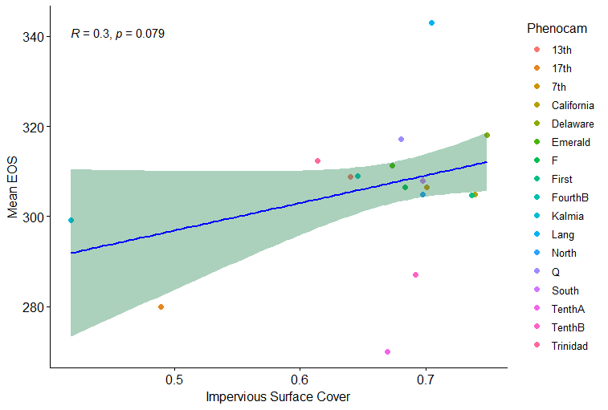
Ordinary Least Squares Model: EOS & Impervious Surface Cover
Results

Slide 26
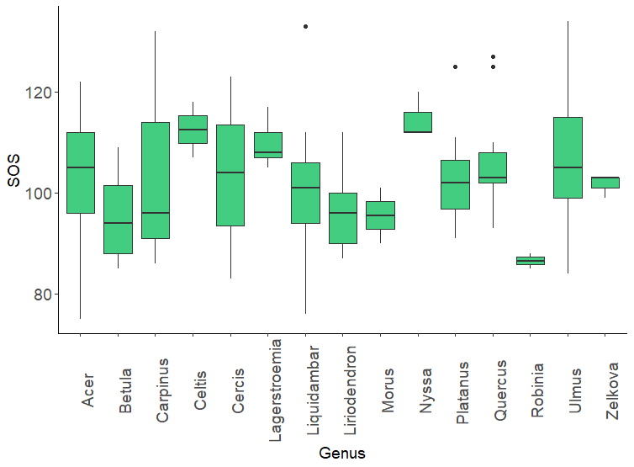
Phenometric Differences in Genera
Results

Slide 27
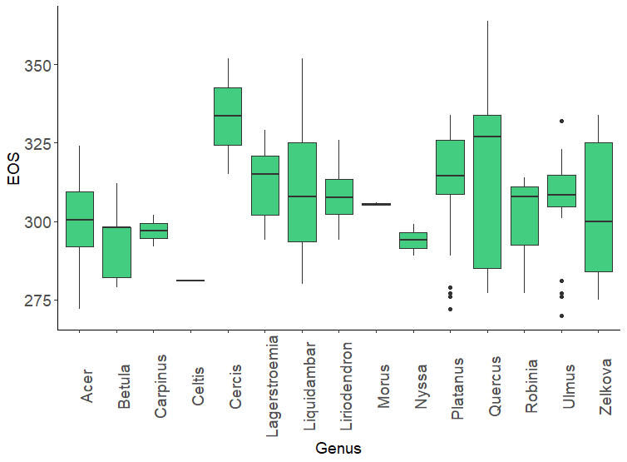
Phenometric Differences in Genera
Results

Slide 28
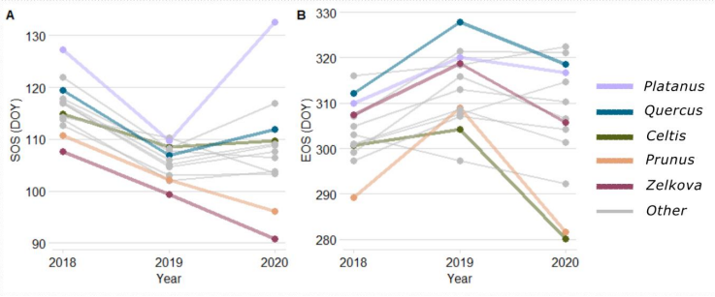
Interannual Genera Differences
Results
Median phenometric values for each genera plotted across three years. A) SOS, B) EOS (Alonzo et al. accepted).

Slide 29
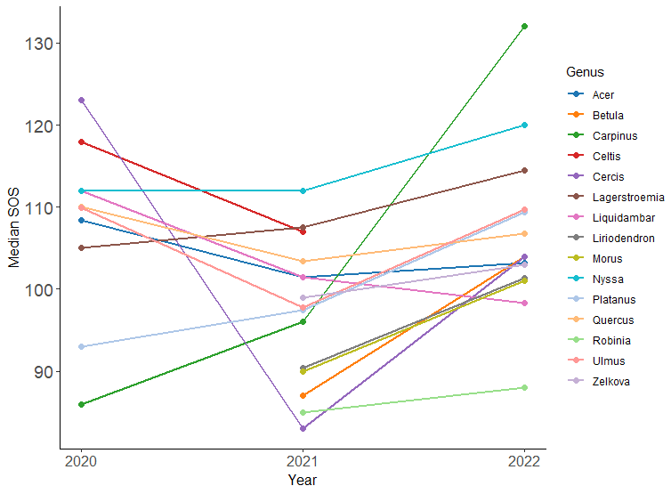
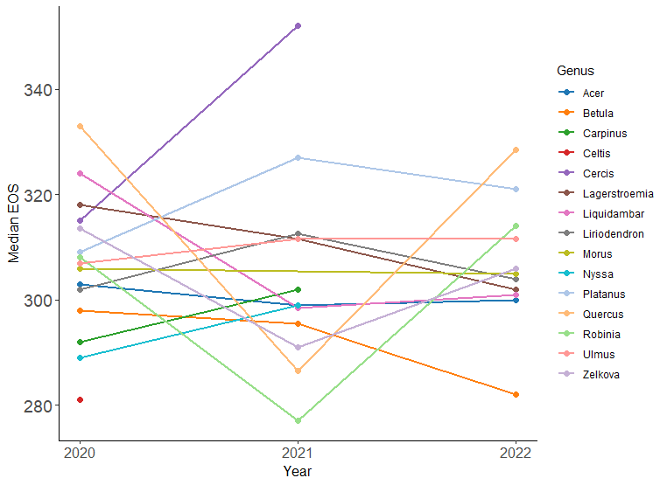
Interannual Genera Differences
Results

Slide 30
Assessing Phenocams
Results
Phenocam | SOS 2020 | EOS 2020 | SOS 2021 | EOS 2021 | SOS 2022 | EOS 2022
Trinidad Ave | Active | Active | Active | Active | Active | Active
17th St. | Active | Active | Active | Active | Inactive | Inactive
First St. | Active | Active | Active | Active | Active | Active
Lang Pl. | Active | Active | Active | Active | Active | Active
A 10th St. | Active | Active | Inactive | Inactive | Inactive | Inactive
A 4th St. | Active | Inactive | Inactive | Inactive | Inactive | Inactive
B 10th St. | Active | Active | Active | Active | Active | Active
B 4th St. | Active | Inactive | Inactive | Inactive | Inactive | Inactive
Delaware Ave |  | Active | Active | Active | Active | Active
13th St. |  | Active | Active | Active | Active | Active
Phenocam | SOS 2020 | EOS 2020 | SOS 2021 | EOS 2021 | SOS 2022 | EOS 2022
California St. |  | Active | Active | Active | Active | Active
Emerald St. |  | Active | Active | Active | Active | Active
Q St. |  | Active | Active | Active | Active | Active
7th St. |  | Active | Active | Active | Active | Active
F St. |  | Active | Active | Active | Active | Active
Pershing Dr. |  | Active | Active | Active | Active | Active
HoS North |  | Active | Active | Active | Active | Active
HoS South |  | Active | Active | Active | Active | Active
Kalmia Rd. |  | Active | Active | Active | Active | Active

Slide 31
Discussion and Conclusion
Aim 1:
Significant SOS differences between years
SOS delayed by ~ 1.8 to 2.6 days as temperature increases
Aim 2:
Significant phenometric differences across genera
EOS delayed by ~ 5.9 days for every 10% increase in impervious surface cover

Slide 32
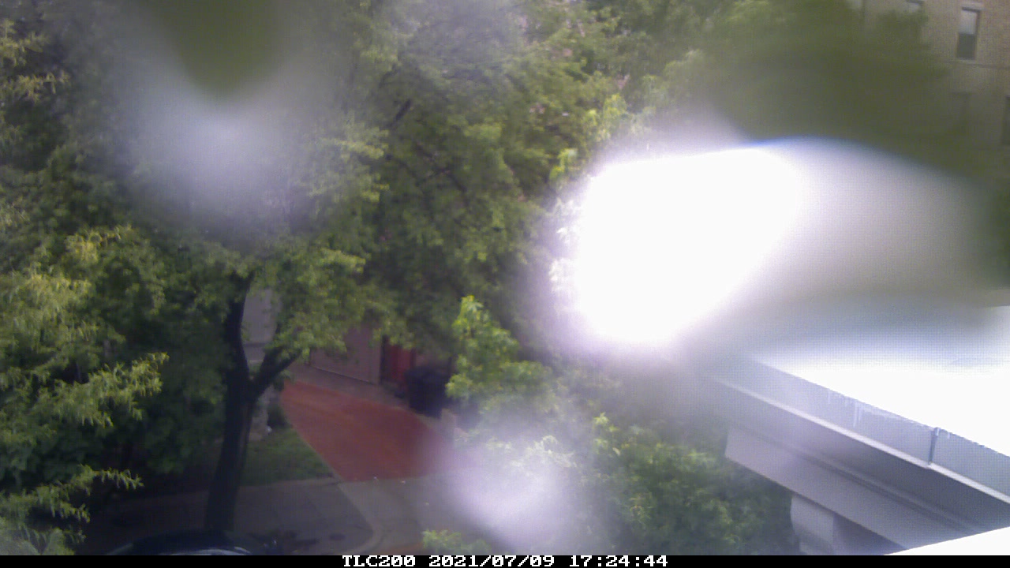
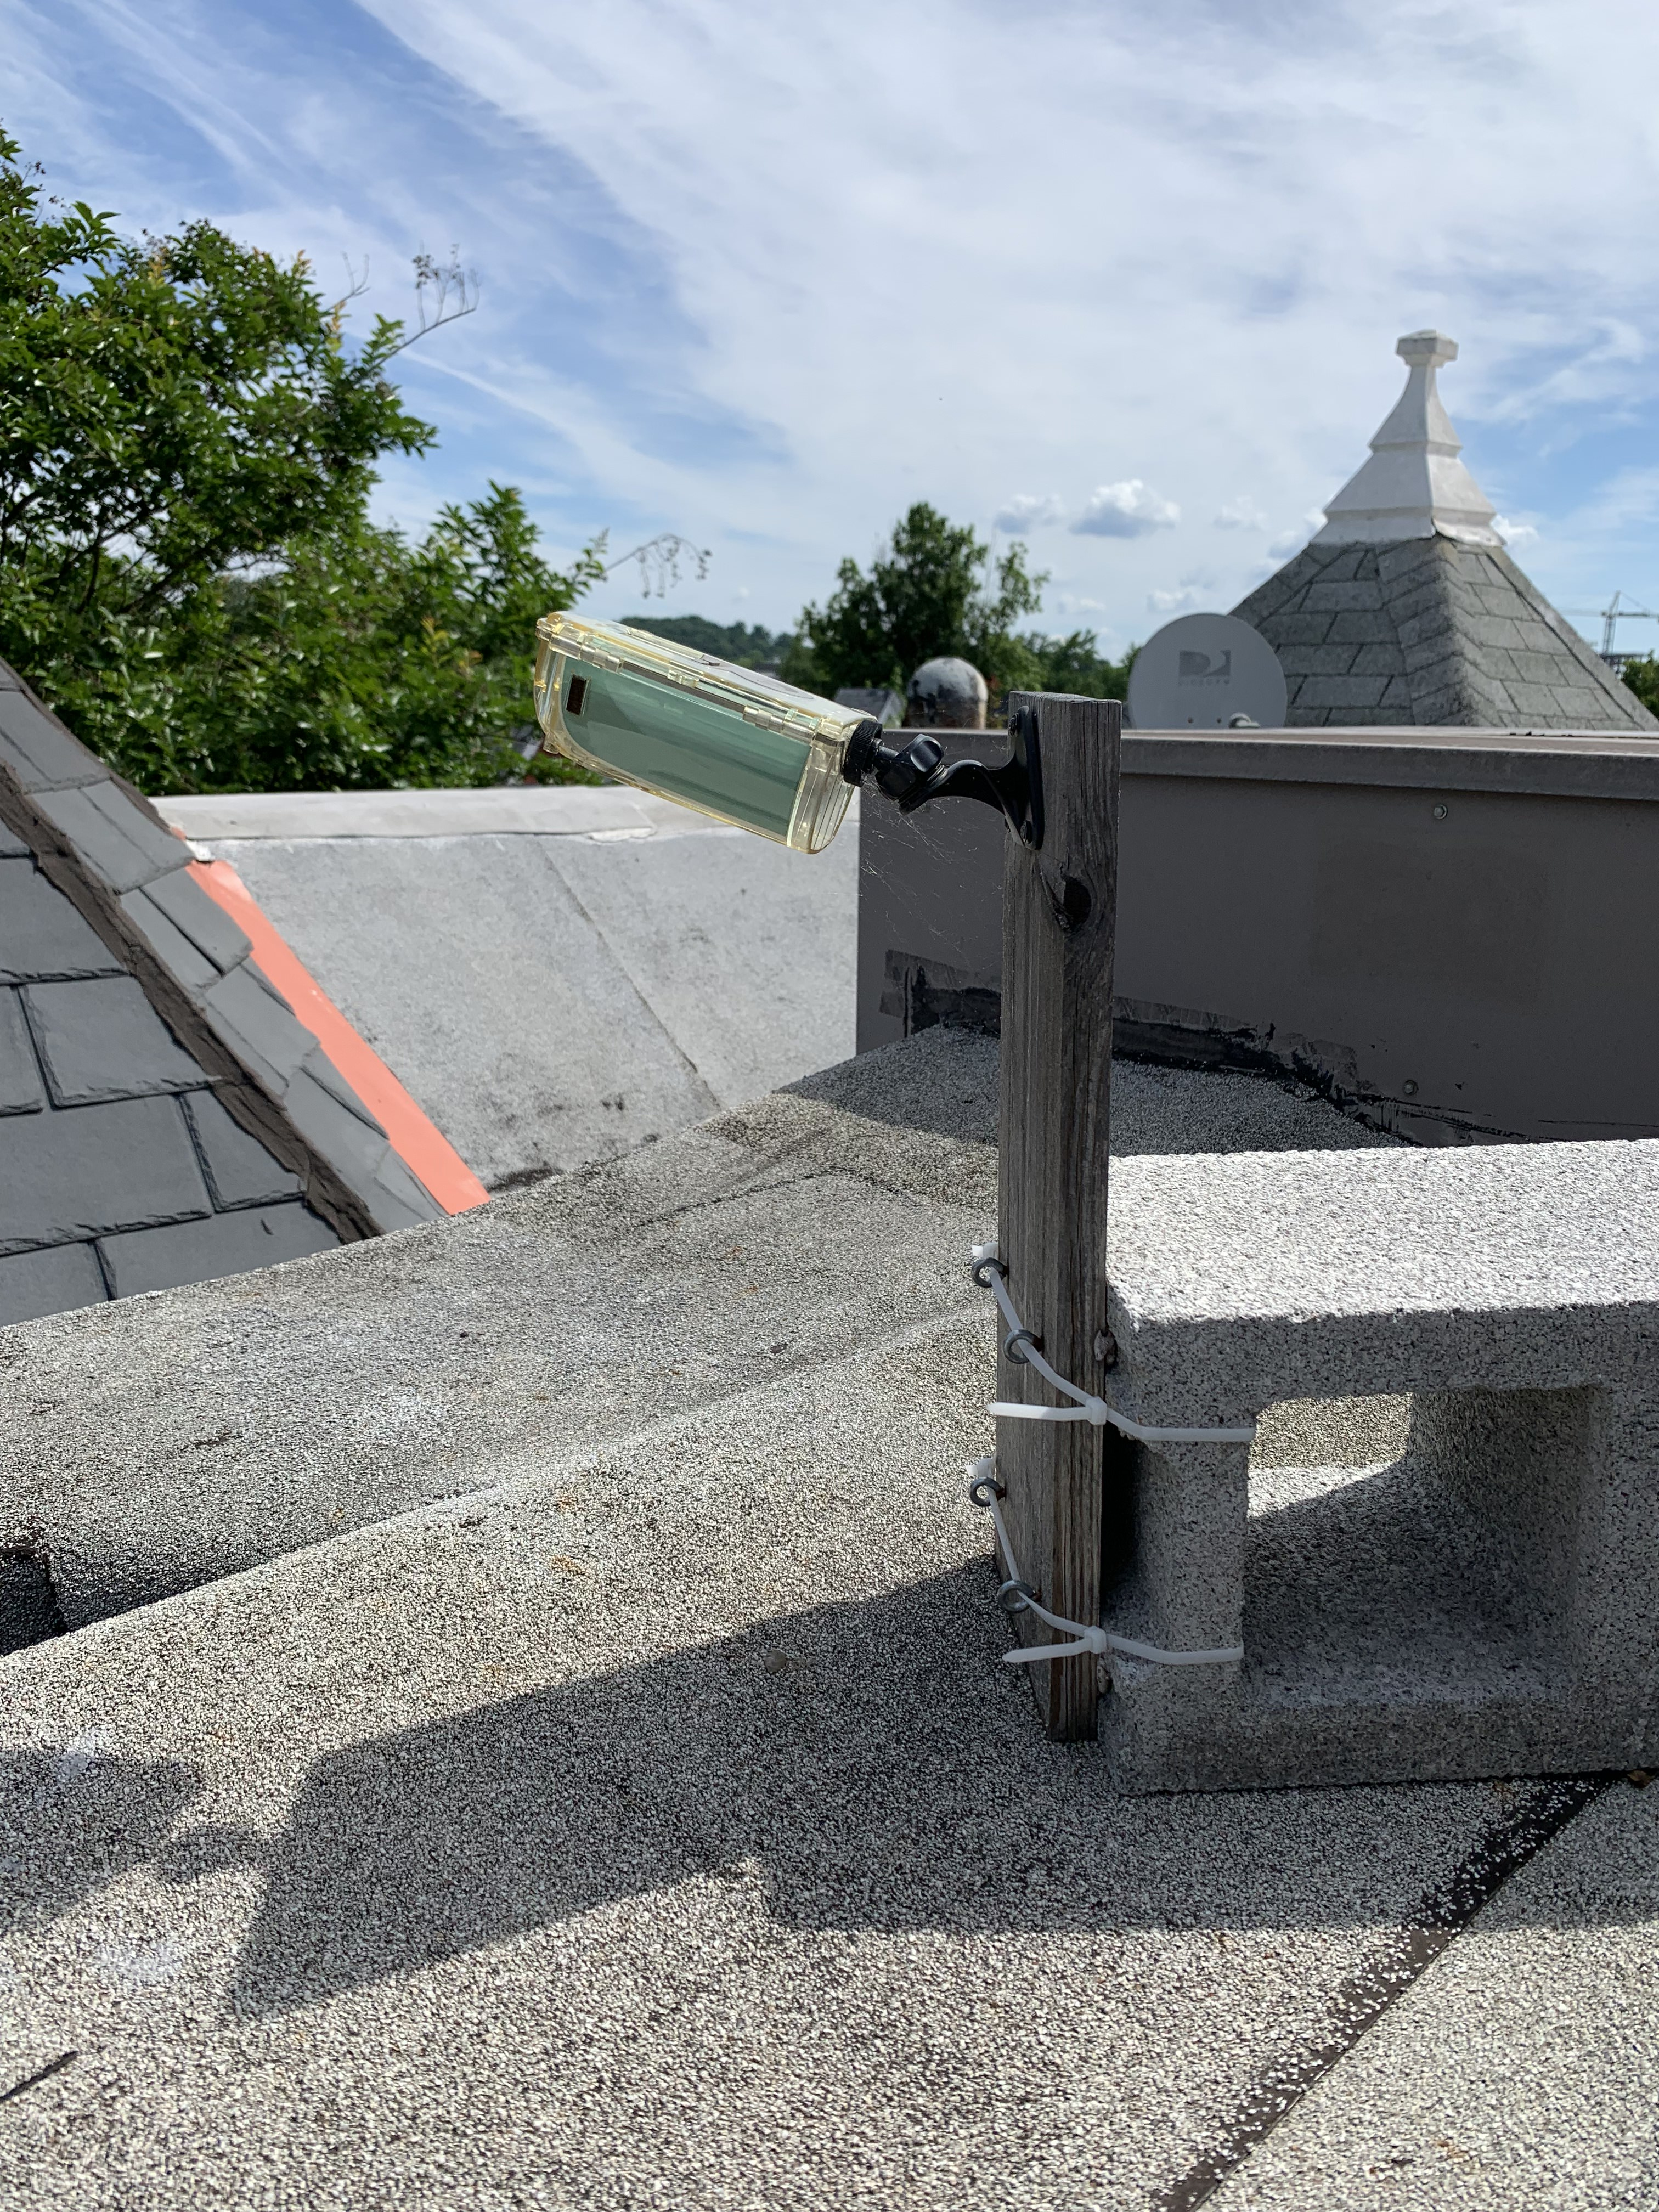
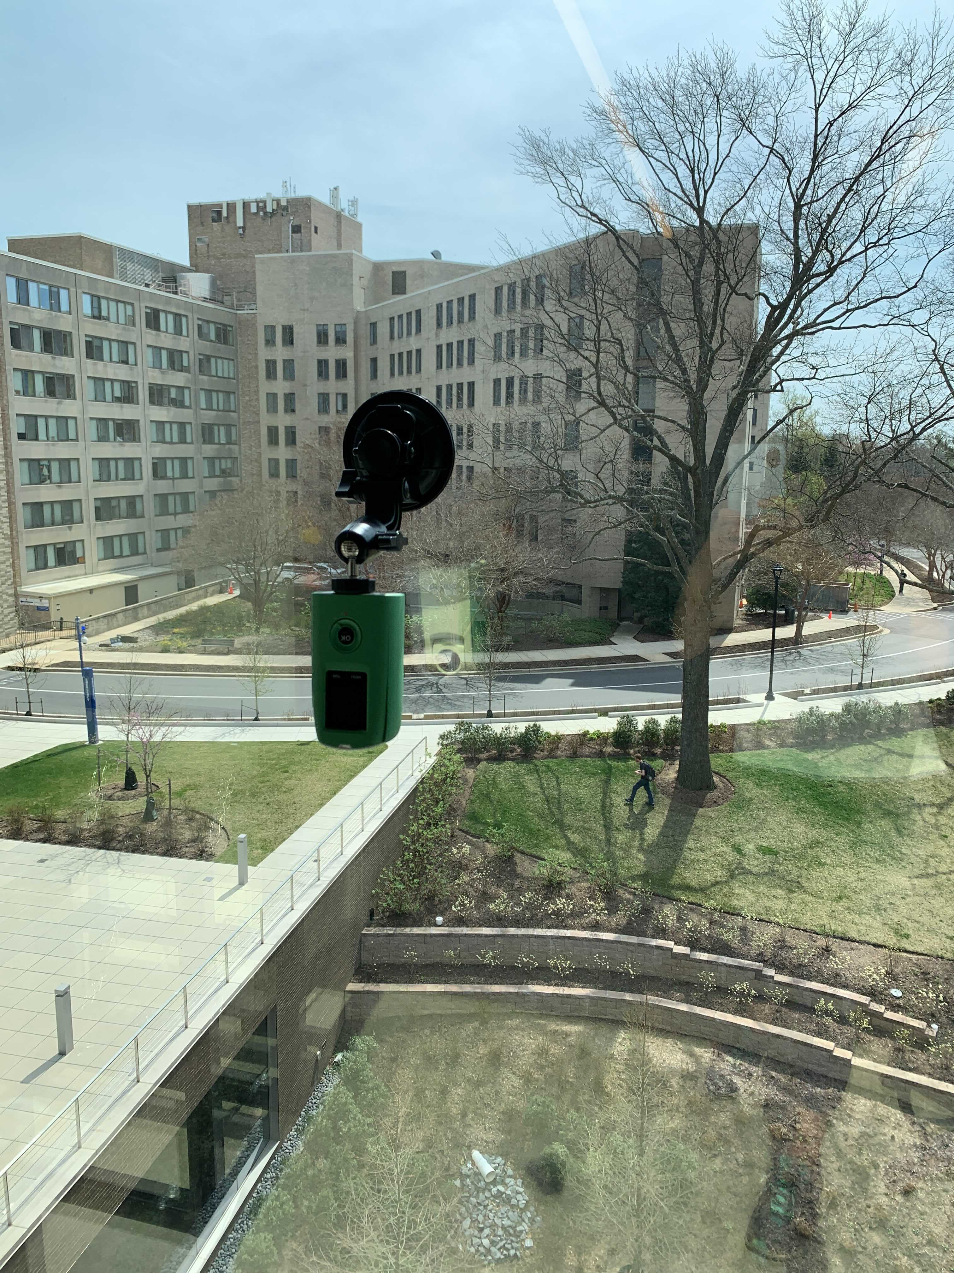
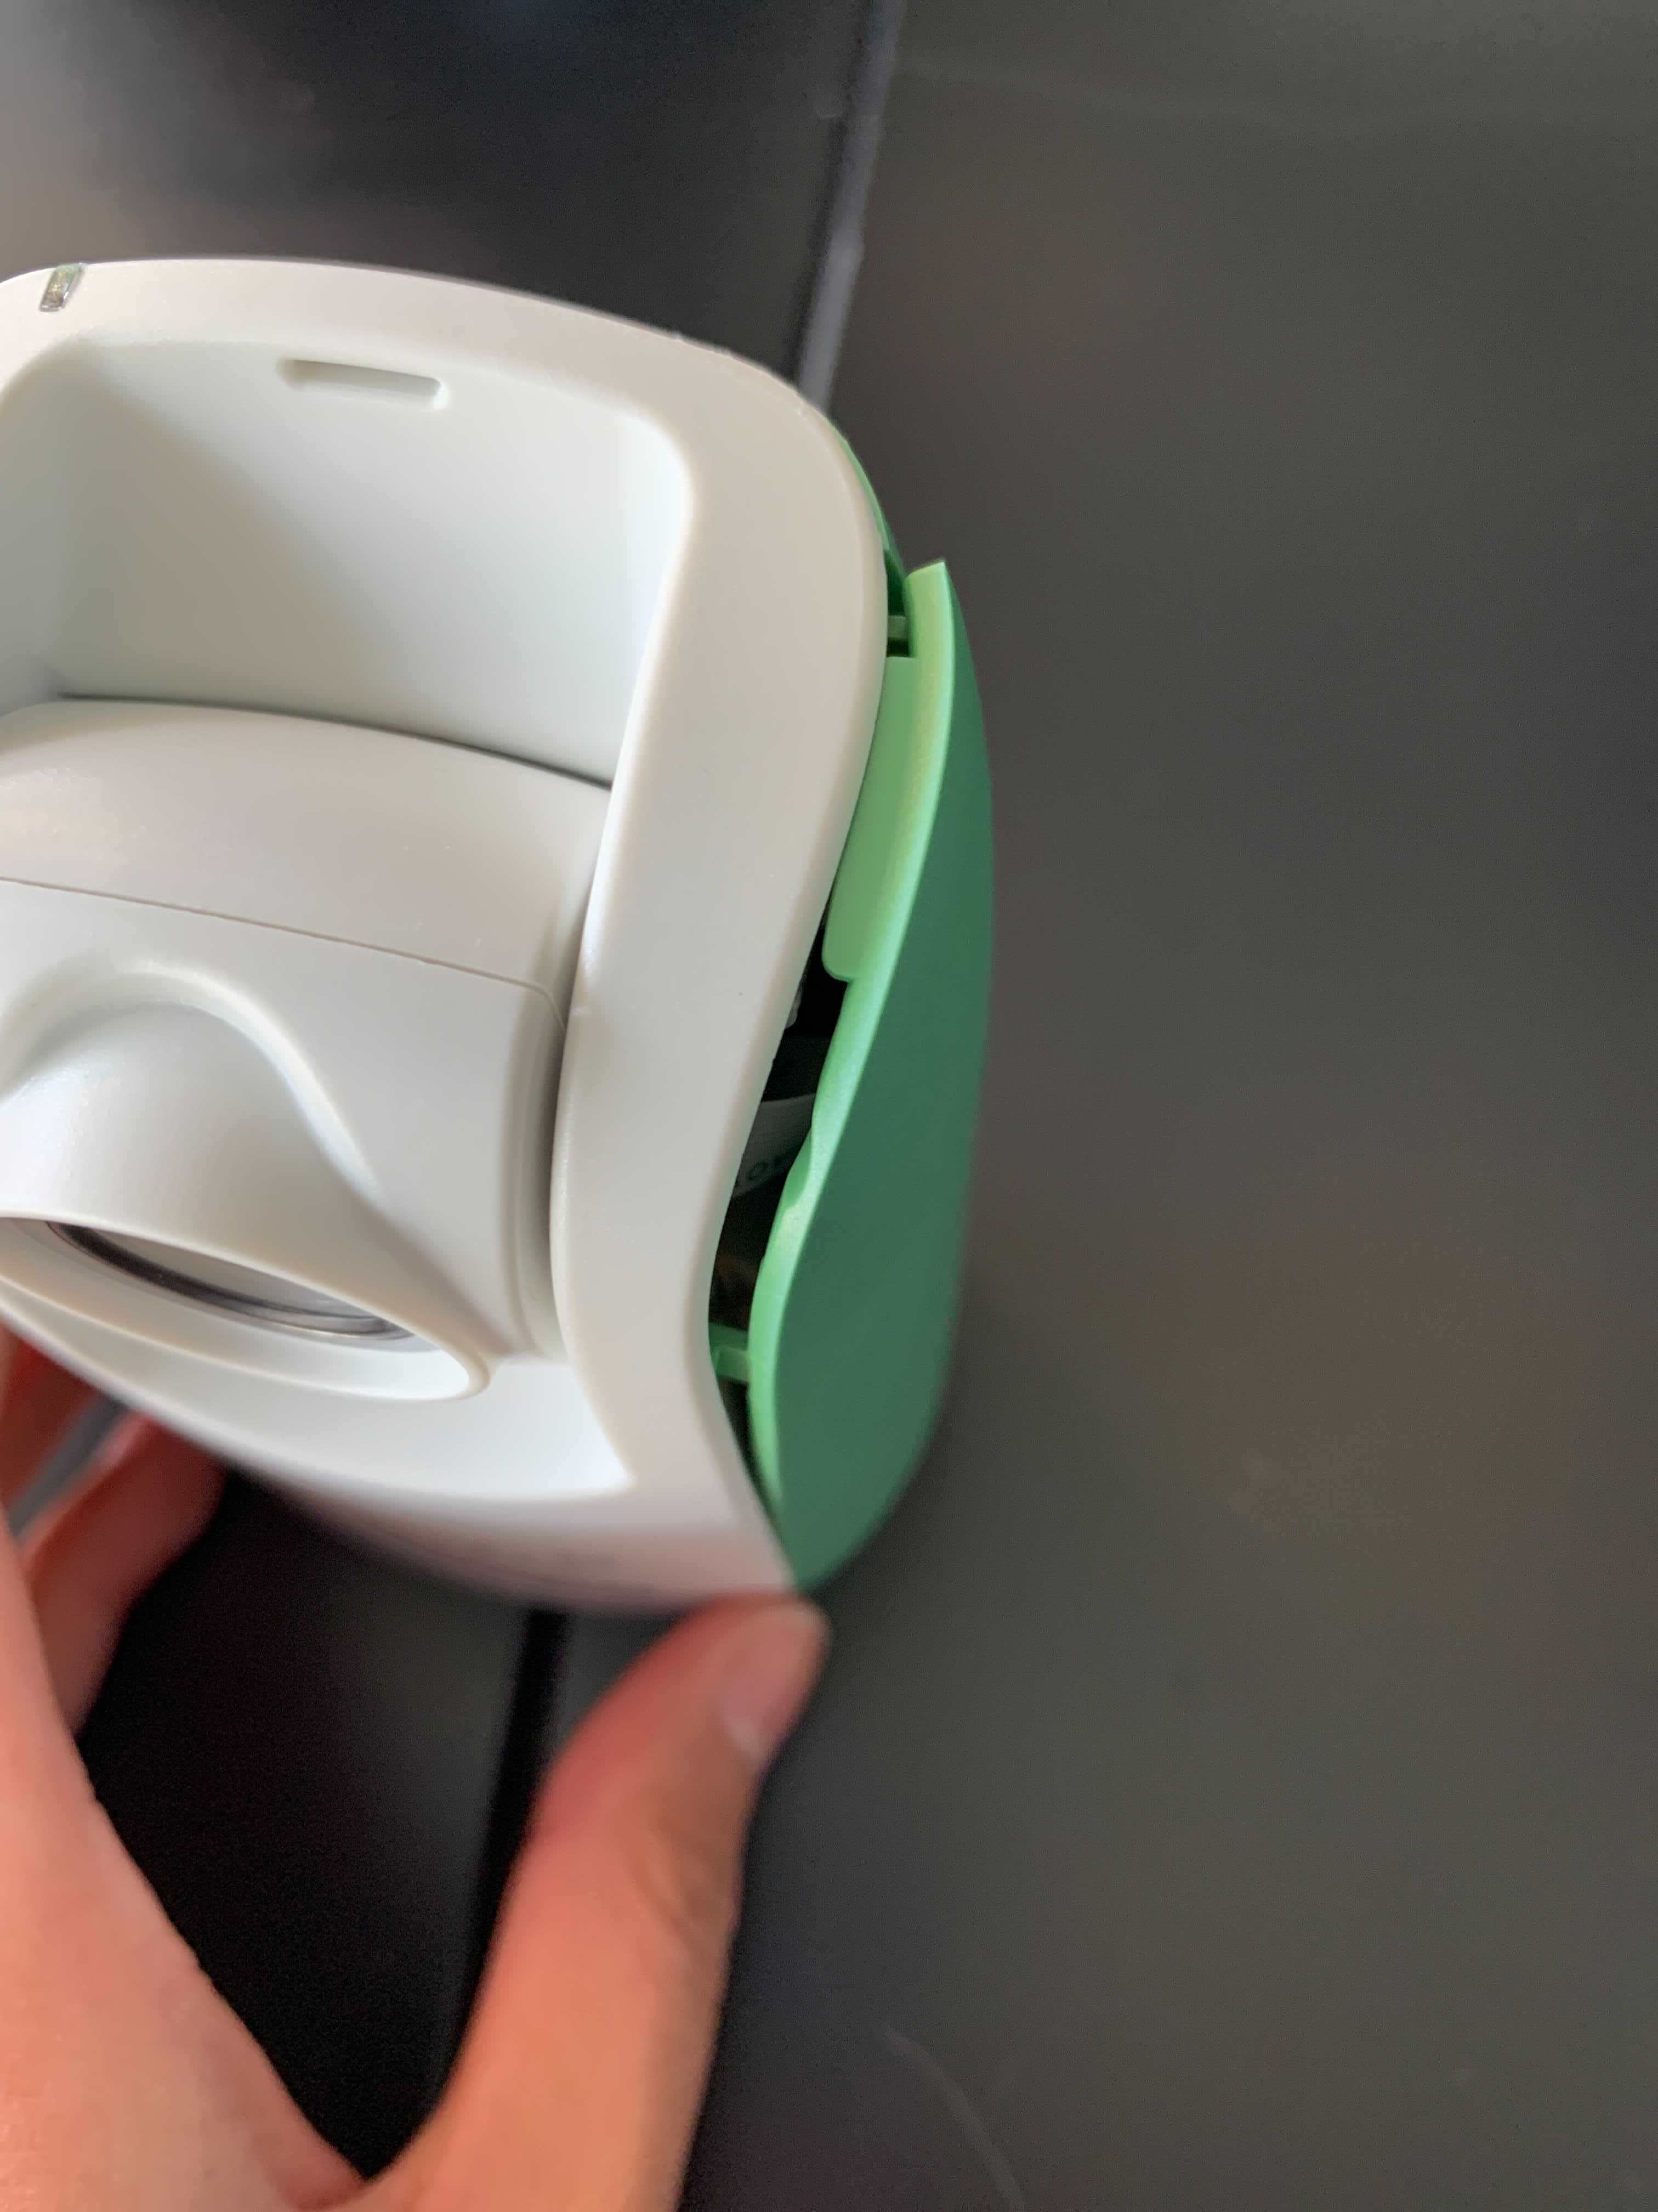
Discussion and Conclusion
Aim 3:
Urban locations add complexity to phenocam set-ups
Type of phenocam matters
Volunteers as phenocam hosts increase educational reach of project, but site variation adds noise

Slide 33
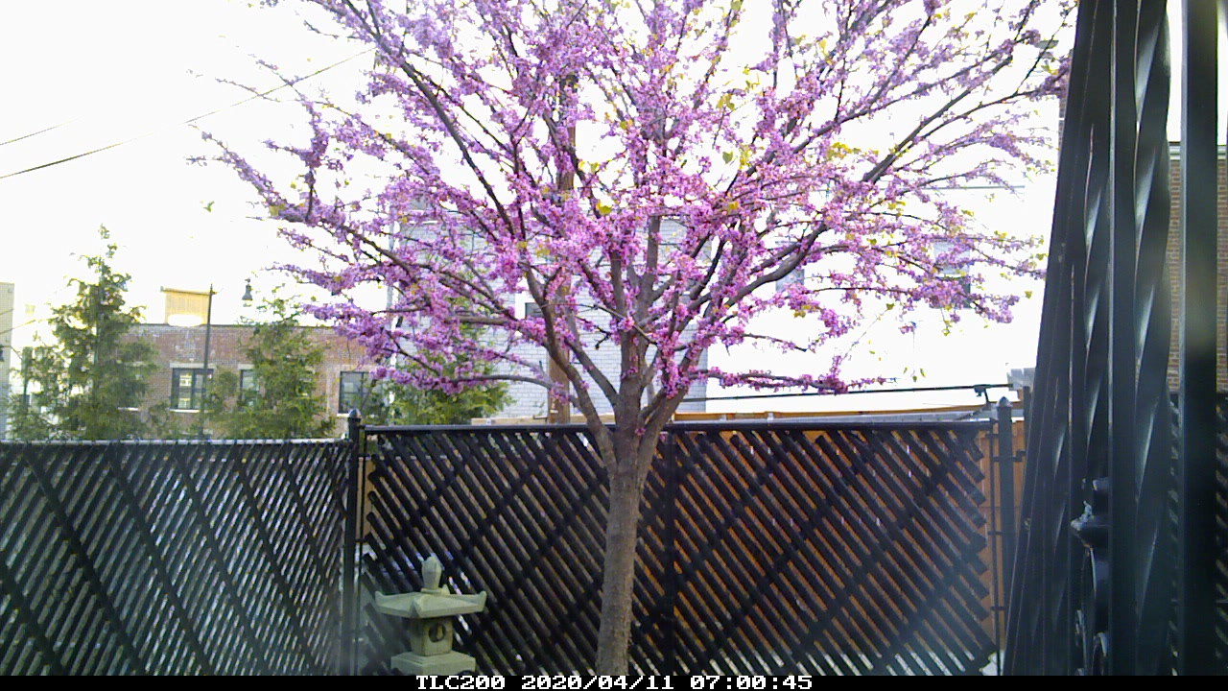
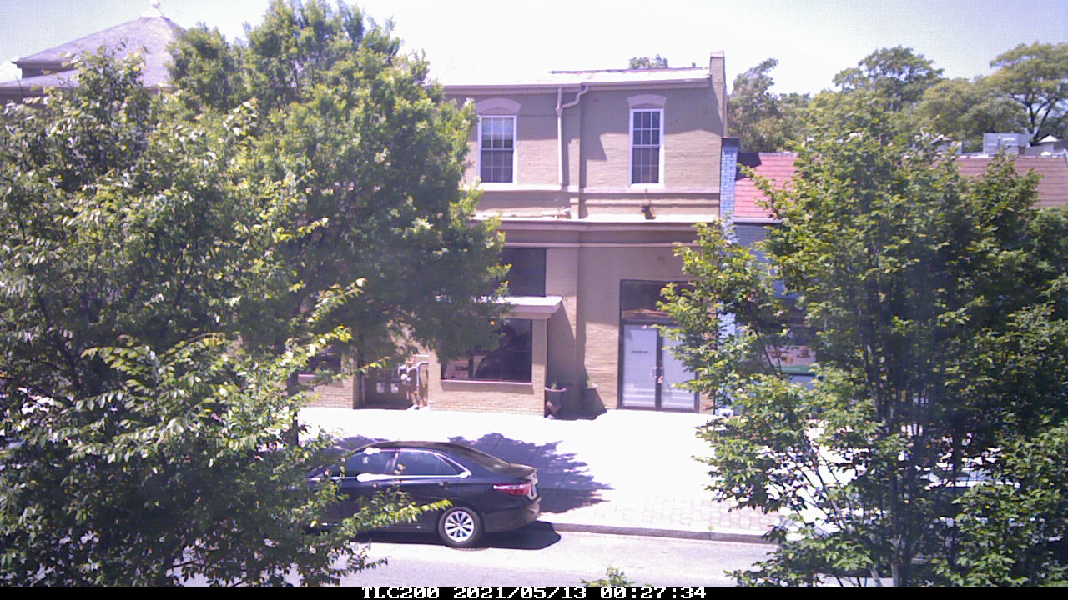
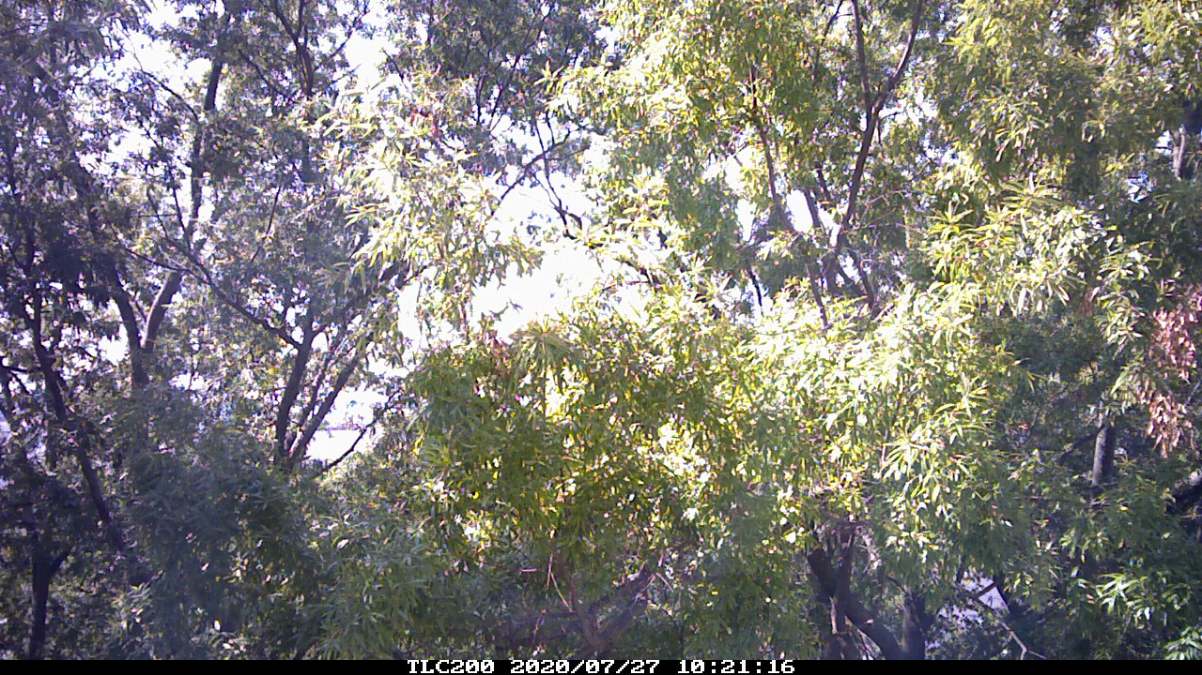
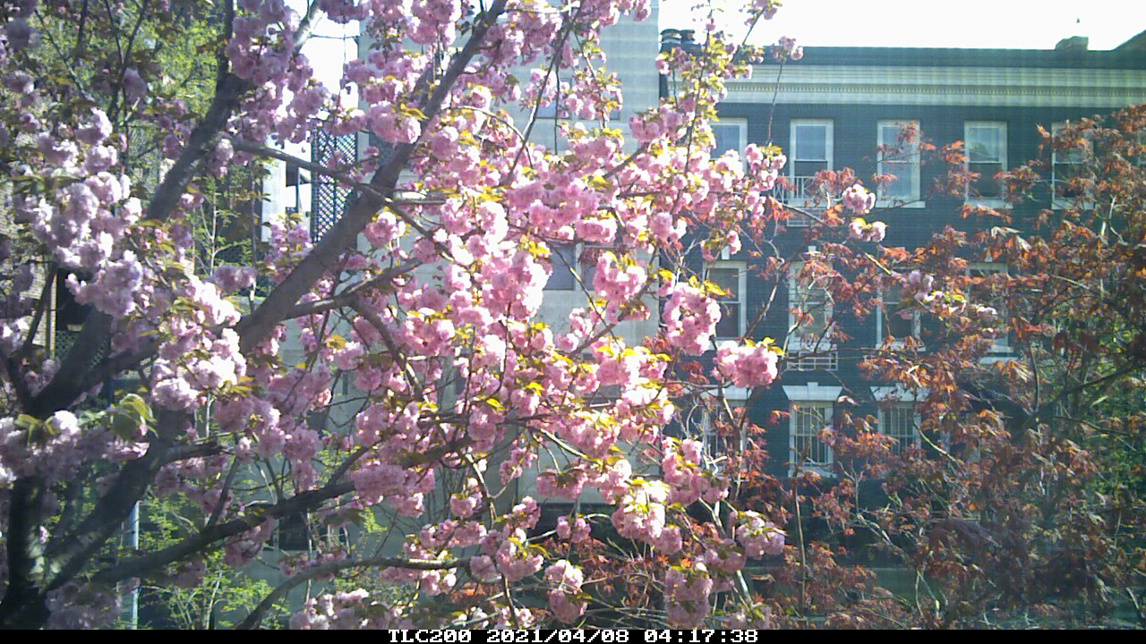
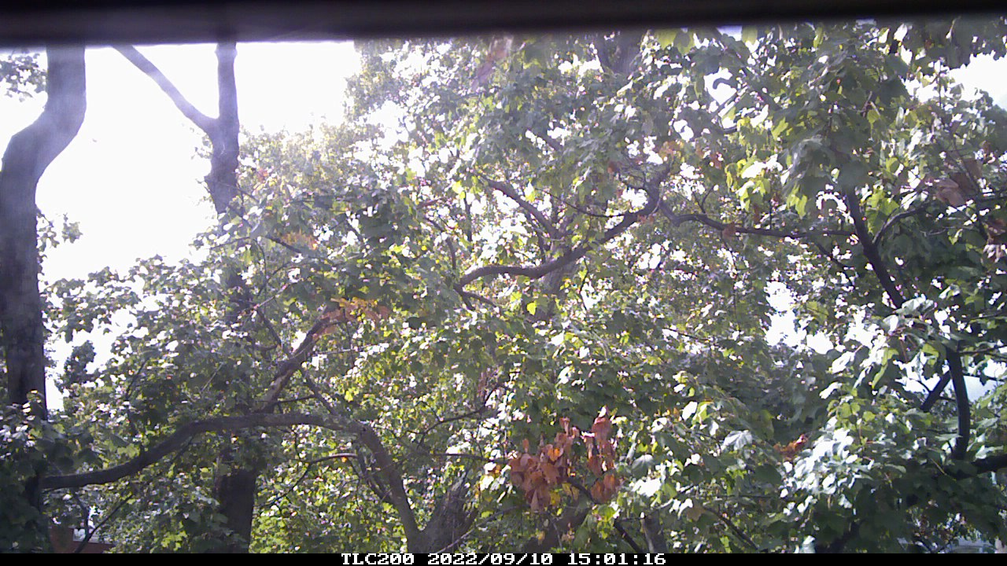
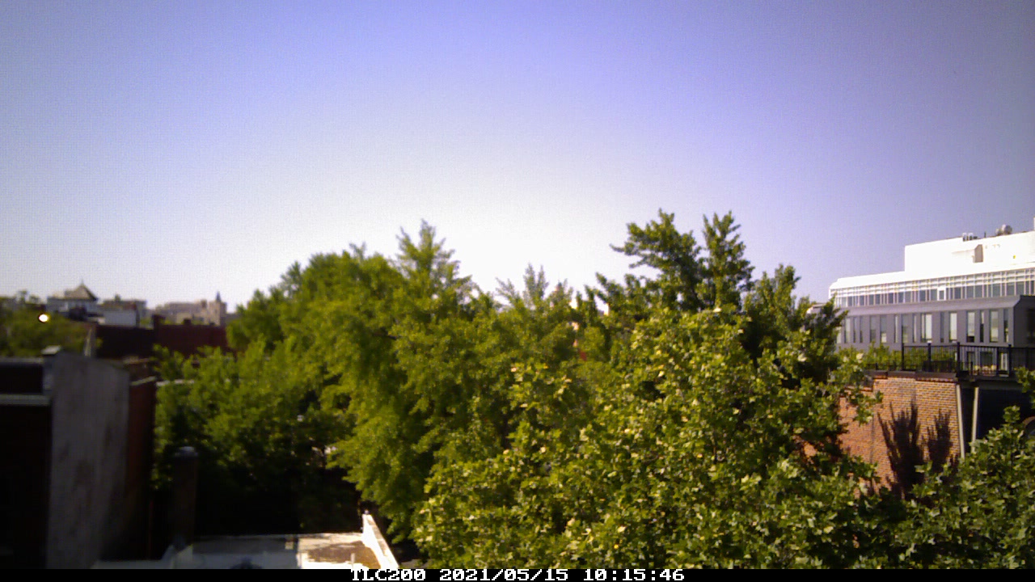
Recommendations
Discussion and Conclusion
Continuous power source
Prioritize high installation
High selectivity of phenocam model and mount type

Slide 34

Acknowledgements
Thank You!
Dr. Michael Alonzo, for expertise and mentorship throughout the duration of this project
Dr. Valentina Aquila and Dr. Sauleh Siddiqui, for serving on my committee and providing guidance
Dr. Thu Ya Kyaw, for encouragement and statistical support
Volunteers, for hosting phenocams and great discussions
Family and Friends, for bringing me endless love and laughs these past two years
Funding Sources:
American University Graduate Assistantship
National Science Foundation (Grant No. 1951647)

Slide 35
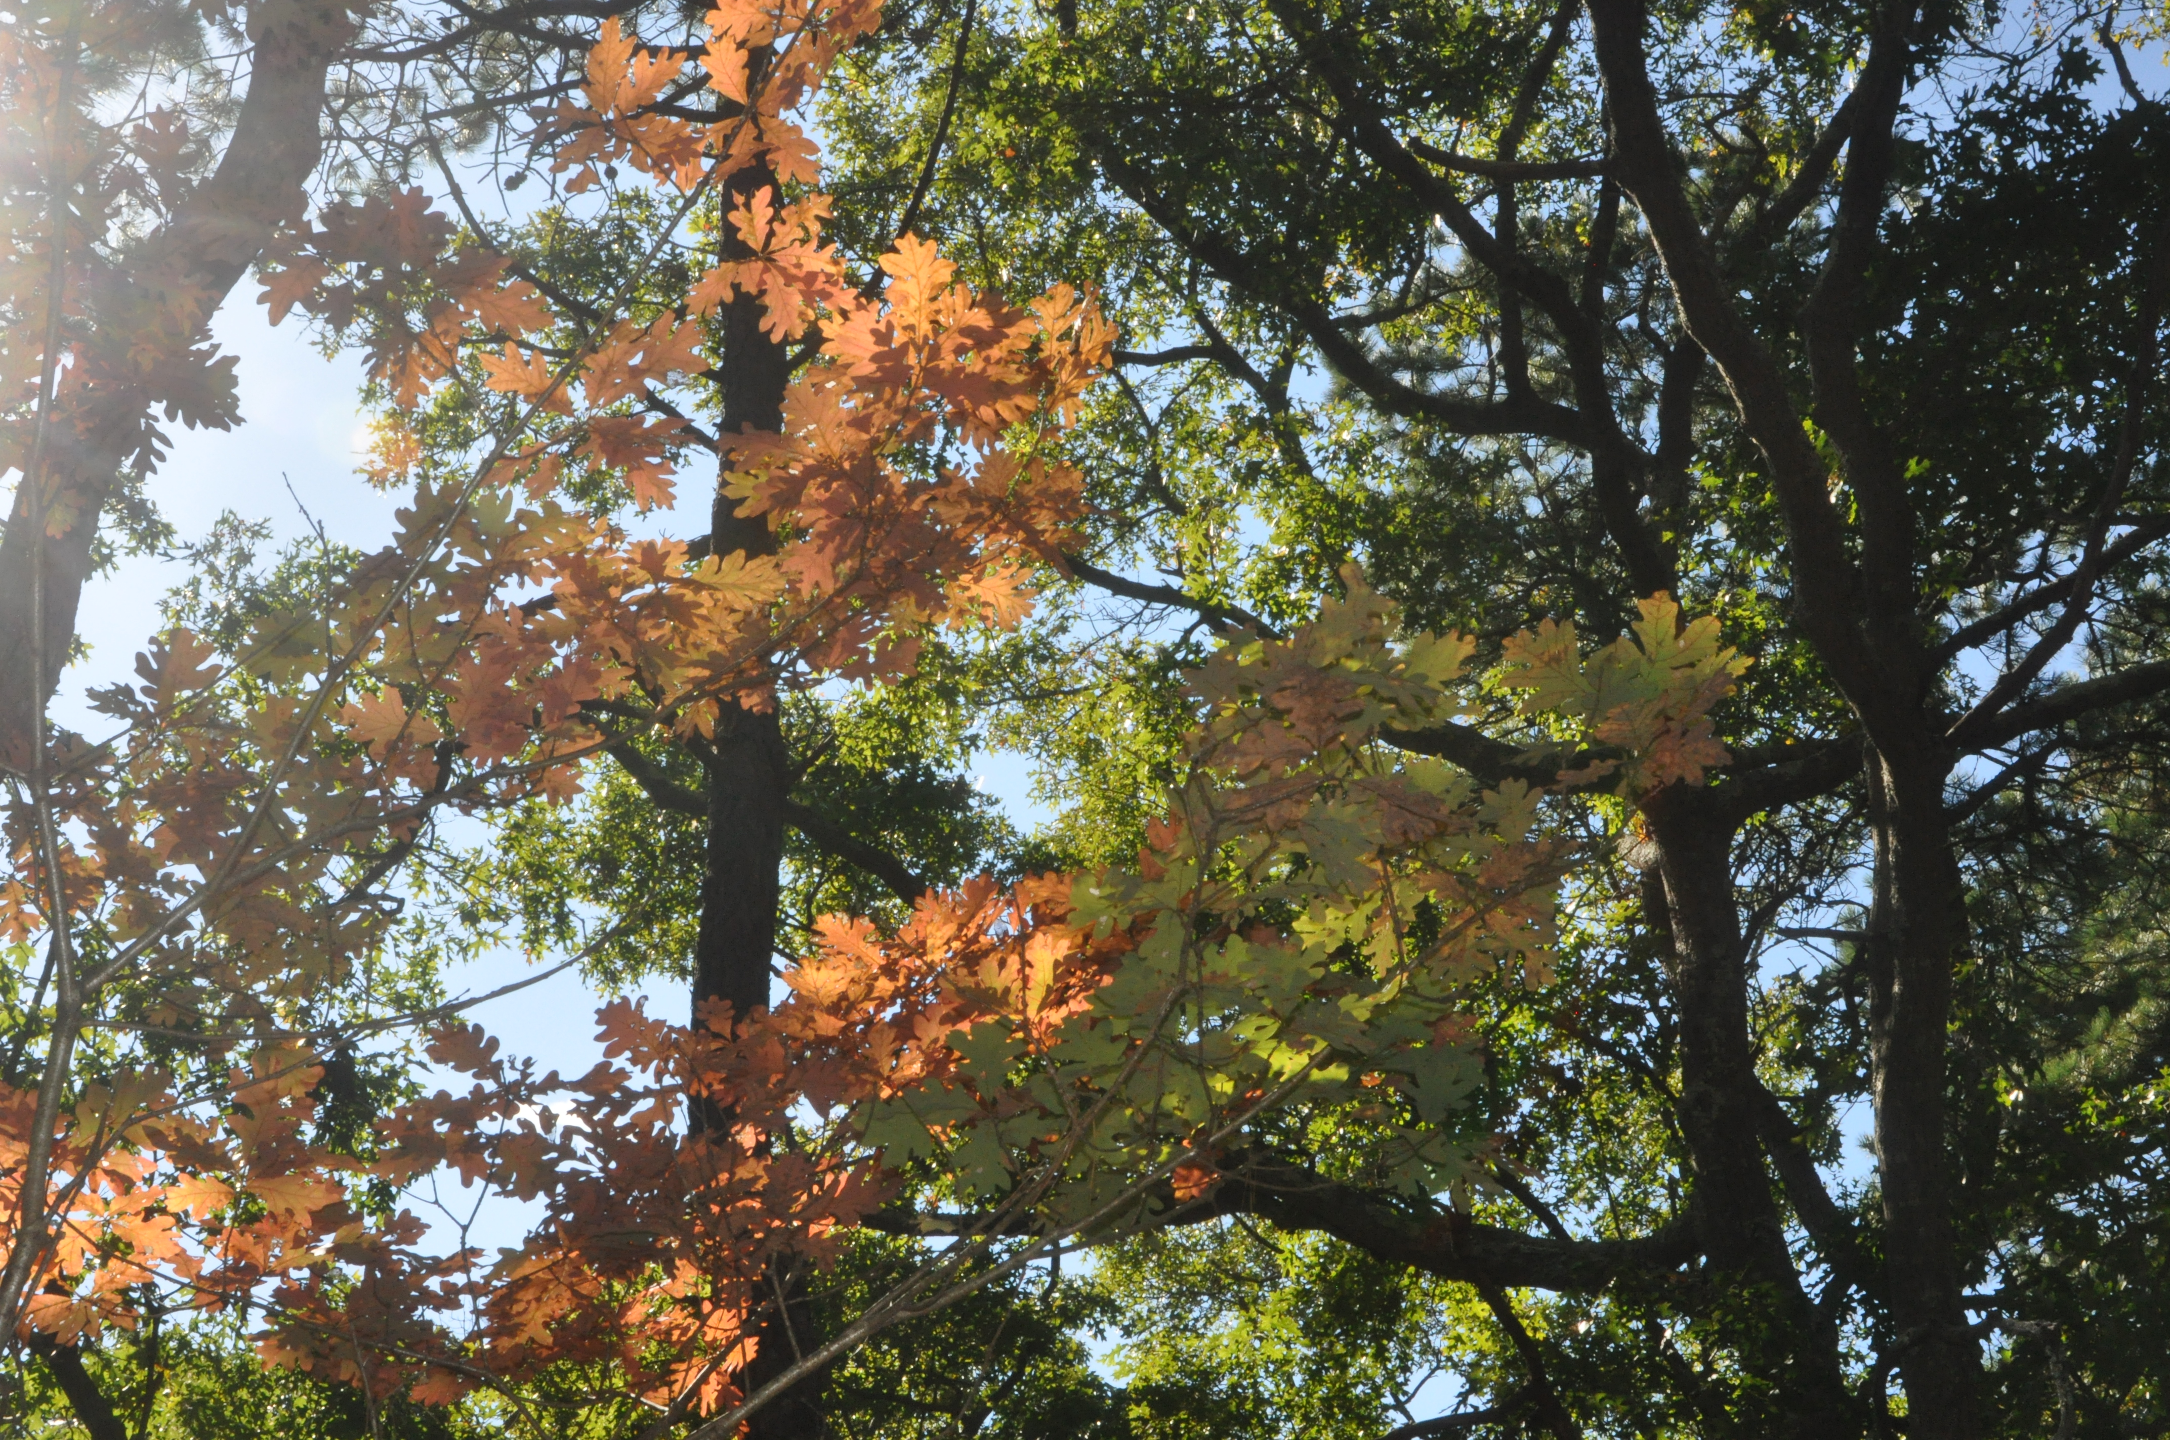
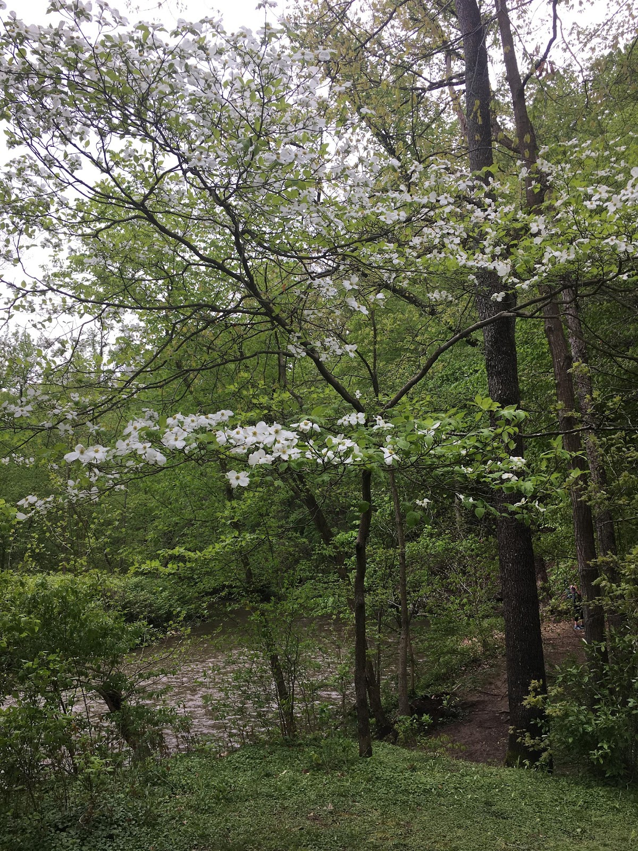
Any Questions?

Slide 36
References
Aasen, H., Kirchgessner, N., Walter, A., & Liebisch, F. (2020). PhenoCams for Field Phenotyping: Using Very High Temporal Resolution Digital Repeated Photography to Investigate Interactions of Growth, Phenology, and Harvest Traits. Frontiers in Plant Science, 11. https://doi.org/10.3389/fpls.2020.00593
Alonzo, M., Baker, M. E., Gao, Y., & Shandas, V. (2021). Spatial configuration and time of day impact the magnitude of urban tree canopy cooling. Environmental Research Letters, 16(8). https://doi.org/10.1088/1748-9326/ac12f2
Basler, David, Körner, Christian. Photoperiod and temperature responses of bud swelling and bud burst in four temperate forest tree species. 2014. 10.1093/treephys/tpu021. Tree Physiology. Vol 34. 4. 377. 388. 0829-318X. 7/14/2022. https://doi.org/10.1093/treephys/tpu021
Bolton, D, K., Gray, J.M, Melaas, E.K., Moon, M., Eklundh, L. and M.A. Friedl (2020). Continental-scale land surface phenology from harmonized Landsat 8 and Sentinel-2 imagery, Remote Sensing of Environment, 240, https://doi.org/10.1016/j.rse.2020.111685.
Cleland, E. E., Chuine, I., Menzel, A., Mooney, H. A., & Schwartz, M. D. (2007). Shifting plant phenology in response to global change. In Trends in Ecology and Evolution (Vol. 22, Issue 7, pp. 357–365). https://doi.org/10.1016/j.tree.2007.04.003
Imhoff, M. L., Zhang, P., Wolfe, R. E., & Bounoua, L. (2010). Remote sensing of the urban heat island effect across biomes in the continental USA. Remote Sensing of Environment, 114(3), 504–513. https://doi.org/10.1016/j.rse.2009.10.008
Richardson, A. D., Hufkens, K., Milliman, T., Aubrecht, D. M., Chen, M., Gray, J. M., Johnston, M. R., Keenan, T. F., Klosterman, S. T., Kosmala, M., Melaas, E. K., Friedl, M. A., & Frolking, S. (2018). Tracking vegetation phenology across diverse North American biomes using PhenoCam imagery. Scientific Data, 5. https://doi.org/10.1038/sdata.2018.28
Shandas, V., Voelkel, J., Williams, J., & Hoffman, J. (2019). Integrating Satellite and Ground Measurements for Predicting Locations of Extreme Urban Heat. Climate, 7(1), 5. MDPI AG. Retrieved from http://dx.doi.org/10.3390/cli7010005
Song, Peng, Sexton, Joseph O., Huang, Chengquan, Channan, Saurabh, Townshend, John R., Characterizing the magnitude, timing and duration of urban growth from time series of Landsat-based estimates of impervious cover, Remote Sensing of Environment, Volume 175, 2016, Pages 1-13, ISSN 0034-4257, https://doi.org/10.1016/j.rse.2015.12.027.
Sonnentag, O., Hufkens, K., Teshera-Sterne, C., Young, A. M., Friedl, M., Braswell, B. H., Milliman, T., O’Keefe, J., & Richardson, A. D. (2012). Digital repeat photography for phenological research in forest ecosystems. Agricultural and Forest Meteorology, 152(1), 159–177. https://doi.org/10.1016/j.agrformet.2011.09.009
Zipper, S. C., Schatz, J., Singh, A., Kucharik, C. J., Townsend, P. A., & Loheide, S. P. (2016). Urban heat island impacts on plant phenology: Intra-urban variability and response to land cover. Environmental Research Letters, 11(5). https://doi.org/10.1088/1748-9326/11/5/054023

